Slide 1
In The Name Of GOD
The Most Compassionate,
The Most Merciful

Slide 2
DAPT/TT BLEEDING
Bleeding is a frequent complication both in patients treated with oral anticoagulation (OAC) and in patients with antiplatelet therapy
Major bleeding occurs in roughly 5% within one year in both groups
Despite the bleeding risk, dual antiplatelet therapy (DAPT), remains the cornerstone of treatment in patients with acute coronary syndrome (ACS) and those undergoing percutaneous coronary intervention (PCI) with stenting

Slide 3



Ischemic/Bleeding Risks Evolution After ACS
Bleeding
Thrombosis
M1
Thrombotic risk > Bleeding risk
Bleeding risk > Thrombotic risk
Cuisset T, et al. Eur Heart Journal. 2017;38(41):3070-3078.
ACS: acute coronary syndrome M1: 1 month.
Zinc code : SAGLB.CLO.18.01.0071b Date of approval : 20 May 2019
This is for internal use only and subsequent use in the affiliates is subject to local review and approval.
Notes:
It is suggested that the danger of thromboembolism is greater than that of bleeding within 1 month after ACS stent implantation. Also, the risk of bleeding is greater after 1 month than that of thromboembolism. Therefore, patient medication cannot be fixed and should be based on a risk assessment prior to choosing a medication.
Reference
Cuisset T, Deharo P, Quilici J, et al. Benefit of switching dual antiplatelet therapy after acute coronary syndrome: The TOPIC (timing of platelet inhibition after acute coronary syndrome) randomized study. Eur Heart Journal. 2017;38(41):3070-3078.

Slide 4
The more potent P2Y12 inhibitors, ticagrelor and prasugrel, are preferred over clopidogrel, further increasing the risk of bleeding
The preferred duration of DAPT after ACS is 12 months
In patients with a high bleeding risk a shorter duration should be considered, with a minimum of one month in medically managed patients and 6 months in patients who underwent PCI

Slide 5
Overview of Key Real-World Evidence on Ticagrelor and Clopidogrel (1/3)
Reference | Study design | N | Sponsor | Results
Zocca et al. | Investigator-initiated, prospective, observational study | 2062 | AstraZeneca, Biotronik, Boston Scientific, and Medtronic | DAPT with ticagrelor was associated with an increased risk of adverse events, primarily driven by the rates of major bleeding
Vercellino, et al. | Pre-post case-control study | 416 | AstraZeneca | Ticagrelor did not decrease the composite outcome of in-hospital MACE, but was associated with improved survival at 1 year, when compared with clopidogrel
Sahlen et al. | Prospective cohort study of patients enrolled in the SWEDEHEART Registry | 45,073 | AstraZeneca, The Medicines Company, Boehringer Ingelheim, Bristol Myers Squibb, Pfizer, CSL Behring, Philips | When compared with clopidogrel, ticagrelor was associated with a lower adjusted risk of a composite of death, MI, or stroke, as well as death alone, but a higher risk of PCI-related in-hospital bleeds and bleeding necessitating re-admission
DAPT: Dual antiplatelet therapy; MACE: Major adverse cardiac events; PCI: Percutaneous coronary intervention; MI: Myocardial infarction; SWEDEHEART: Swedish Web system for Enhancement and Development of Evidence-based care in Heart disease Evaluated According to Recommended Therapies;
.
Notes:
The on-screen table provides an overview of the key real-world evidence on ticagrelor and clopidogrel in patients with ACS.
Let us discuss these studies in greater detail in the subsequent slides.

Slide 6
Overview of Key Real-World Evidence on Ticagrelor and Clopidogrel (2/3)
Reference | Study design | N | Sponsor | Results
Chen et al. | Multicentre, retrospective, pilot study | 928 | Taiwan Municipal Hospital Research Grant, the Multidisciplinary Center of Excellence for Clinical Trial and Research | Ticagrelor could confer a marginally favourable effect on the occurrence of vascular death, MI, or stroke. However, these beneficial effects occur at the expense of an increased risk of dyspnoea.
Park et al. | Analysis of the KAMIR-NIH database | 8010 | Korea Centers for Disease Control and Prevention and the Korean Health Technology R&D Project | Compared with clopidogrel, ticagrelor did not decrease ischaemic events; however, it led to a significant increase in the risk of in-hospital bleeding complications, especially in elderly patients and in those with a low body weight.
Vyas et al. | Retrospective, observational study of the Market Scan Commercial Claims and Encounters Database | 11,629 | AstraZeneca | More patients in the ticagrelor group were switched to another P2Y₁₂ agent, whereas more patients in the clopidogrel required hospitalisation and emergency room visits.
DAPT: Dual antiplatelet therapy; MACE: Major adverse cardiac events; PCI: Percutaneous coronary intervention; MI: Myocardial infarction; SWEDEHEART: Swedish Web system for Enhancement and Development of Evidence-based care in Heart disease Evaluated According to Recommended Therapies;
Notes:
The on-screen table provides an overview of the key real-world evidence on ticagrelor and clopidogrel in patients with ACS.
Let us discuss these studies in greater detail in the subsequent slides.

Slide 7
Overview of Key Real-World Evidence on Ticagrelor and Clopidogrel (3/3)
Reference | Study design | N | Sponsor | Results
Coons et al. | Retrospective, observational study | 8127 | Merck & Co., Amgen, Pfizer | According to the propensity analyses, no significant difference was noted between the ticagrelor, switch, and clopidogrel groups for the primary efficacy endpoint of MACE and any bleeding and major bleeding at 1 year
Rasia et al. | Retrospective, observational study | 2404 | Not listed | Incidence of MACE was significantly lower among patients treated with aspirin plus ticagrelor; mainly driven by lower incidence of all-cause mortality and target vessel revascularisation
Angeras, et al. | Observational study using SCAAR data | 12,168 | Swedish health authorities only | Ticagrelor was not superior to clopidogrel
KAMIR-NIH: Korea Acute Myocardial Infarction Registry—National Institute of Health; MACE: Major adverse cardiac events; SCAAR: Swedish Coronary Angiography and Angioplasty; NACE: Net adverse cardiovascular event.
Notes:
The on-screen table provides an overview of the key real-world evidence on ticagrelor and clopidogrel in patients with ACS.
Let us discuss these studies in greater detail in the subsequent slides.

Slide 8
THEMIS
Ticagrelor added to Aspirin in patients with stable CAD and DM

Slide 9
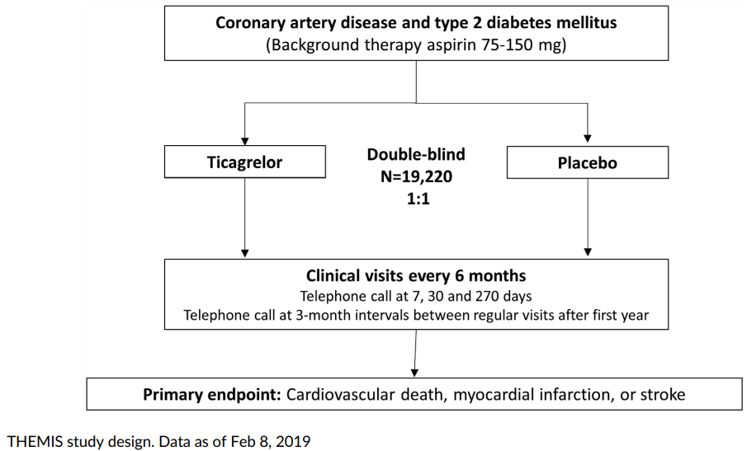
THEMIS study Design (stable CAD + T2DM)

Slide 10
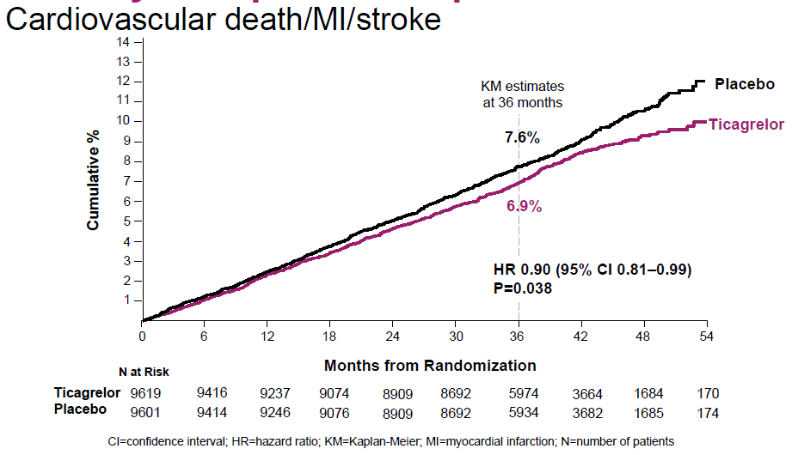
Primary Composite Endpoint

Slide 11
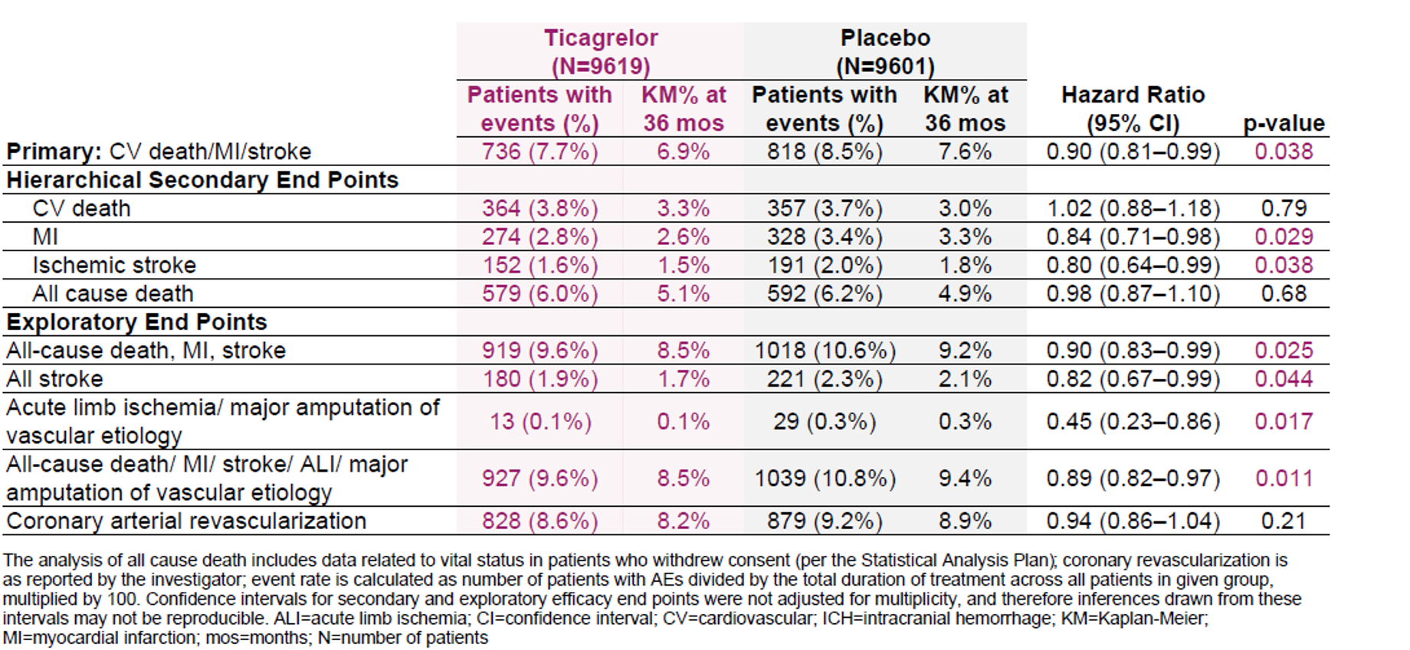
Clinical Outcomes

Slide 12
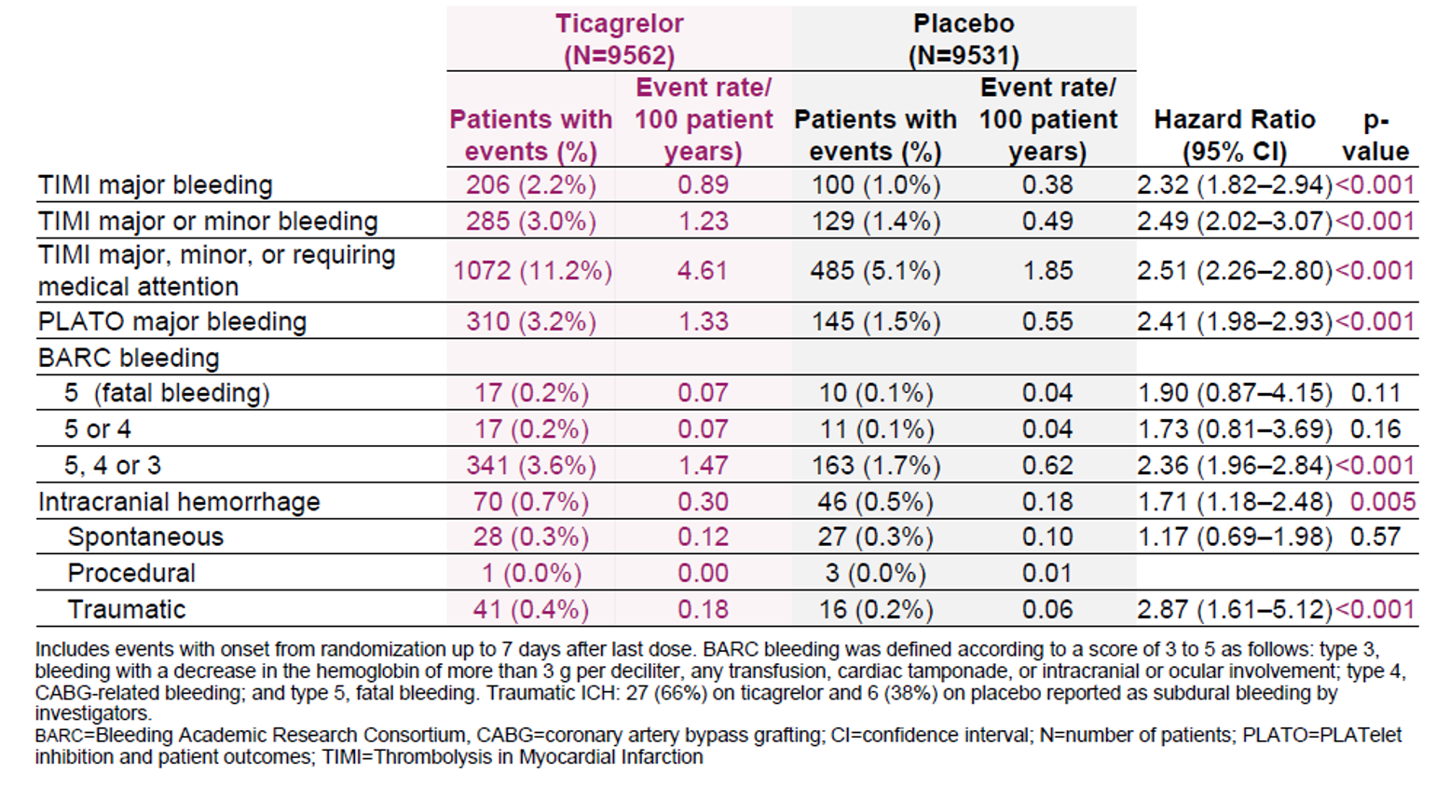
Bleeding Outcomes

Slide 13
THEMIS study
At 3 years, the number needed to treat to prevent 1 ischemic event (NNT) was 136
the number needed to cause 1 major bleeding (NNH) was 93

Slide 14
Bleeding Academic Research Consortium (BARC) definition for Bleeding
Type 0:
No bleeding
Type 1:
Bleeding that is not actionable and does not cause the patient to seek unscheduled performance of studies,
hospitalization, or treatment by a health-care professional; may include episodes leading to
self-discontinuation of medical therapy by the patient without consulting a health-care professional.
Type 2:
Any overt, actionable sign of hemorrhage (e.g., more bleeding than would be expected for a
clinical circumstance, including bleeding found by imaging alone) that does not fit the criteria for type 3, 4, or 5
but does meet at least one of the following criteria:
      requiring nonsurgical, medical intervention by a health-care professional,
      leading to hospitalization or increased level of care, or prompting evaluation

Slide 15
Type 3:
Type 3a:
Overt bleeding plus hemoglobin drop of 3 to < 5 g/dL* (provided hemoglobin drop is related to bleed)
Any transfusion with overt bleeding
Type 3b:
Overt bleeding plus hemoglobin drop ≥5 g/dL* (provided hemoglobin drop is related to bleed),
Cardiac tamponade,
Bleeding requiring surgical intervention for control (excluding dental/nasal/skin/hemorrhoid),
Bleeding requiring intravenous vasoactive agents
Type 3c:
Intracranial hemorrhage (does not include microbleeds or hemorrhagic transformation, does include intraspinal),
Subcategories confirmed by autopsy or imaging or lumbar puncture,
Intraocular bleed compromising vision.

Slide 16
Type 4:
CABG-related bleeding
Perioperative intracranial bleeding within 48 h, Reoperation after closure of sternotomy for the purpose of controlling bleeding Transfusion of ≥ 5 U whole blood or packed red blood cells within a 48-h period, Chest tube output more than or equal to 2L within a 24-h period | ”

Slide 17
Type 5:
Fatal bleeding
Type 5a:
Probable fatal bleeding; no autopsy or imaging confirmation but clinically suspicious
Type 5b:
Definite fatal bleeding; overt bleeding or autopsy or imaging confirmation

Slide 18

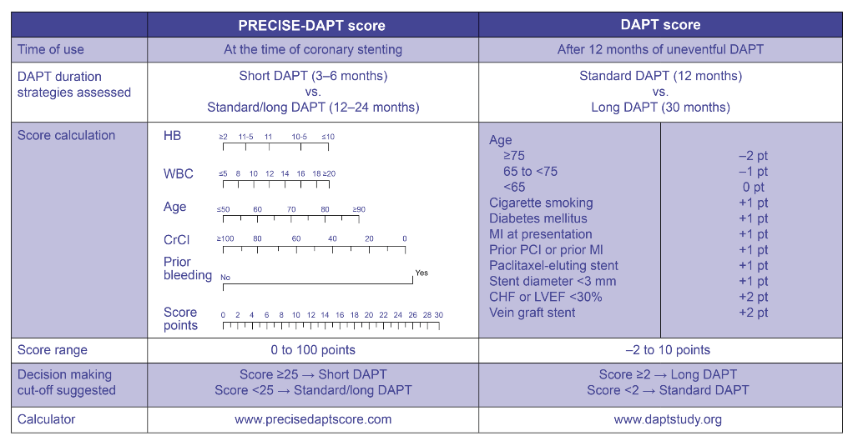
PRECISE-DAPT Score for Duration of Therapy
PRECISE-DAPT: PREdicting bleeding Complications In patients undergoing Stent implantation and subsEquent Dual Anti Platelet Therapy; HB: haemoglobin; WBC: white blood cells, CrCl: creatinine clearance; LVEF: Left ventricular ejection fraction; PCI: Percutaneous coronary intervention; MI: Myocardial infarction; CHF: Chronic heart failure.
Valgimigli M, et al. Eur Heart Journal. 2017. doi: 10.1093/eurheartj/ehx419.
Notes:
Risk scores might be helpful to maximise ischaemic protection and minimise bleeding risks in the tailoring of DAPT. However, the application of these risk scores to decide upon DAPT period is difficult, considering the there are limited data exploring this topic. Nevertheless, the use of risk scores that were primarily formulated to direct and support decision making on DAPT duration should be prioritised over other risk scores, displayed on screen.
Reference
Valgimigli M, Bueno H, Byrne R, et al. 2017 ESC focused update on dual antiplatelet therapy in coronary artery disease developed in collaboration with EACTS: The Task Force for dual antiplatelet therapy in coronary artery disease of the European Society of Cardiology (ESC) and of the European Association for Cardio-Thoracic Surgery (EACTS). Eur Heart Journal. 2017. doi: 10.1093/eurheartj/ehx419.

Slide 19
Major bleeding is associated with a significant increase in the risk of death(11%), myocardial infarction and stroke
Resuming antithrombotic therapy poses a clinical dilemma
Restarting antithrombotic therapy prematurely could lead to recurrent bleeding
Delayed reinitiating puts the patient at an increased thrombotic risk

Slide 20
Trivial Bleeding
Minor bleeding which does not need medical attention
The European Society of Cardiology (ESC) DAP guideline advises to continue DAPT
Re-evaluate DAPT duration
Consider switching from ticagrelor/prasugrel to clopidogrel

Slide 21
Mild Bleed With DAPT
Mild bleeding event, defined as needing medical attention without hospital stay
The guideline advises to continue DAPT
Re-evaluation of DAPT duration
Consider switching from ticagrelor/prasugrel to the clopidogrel

Slide 22
Moderate Bleeding
Significant blood loss (≥2mmol/L hemoglobin) or requires hospitalization, however, the patient is hemodynamically stable
The ESC DAPT guideline recommends interrupting DAPT and switch to single antiplatelet therapy, preferably the P2Y12 inhibitor, especially in upper gastrointestinal bleeding events
Based on limited literature, it has been advised to restart DAPT within 3 days after the bleeding has been stopped

Slide 23
Moderate Bleeding
Consider shortening DAPT duration
Consider switching to the less aggressive P2Y12 inhibitor clopidogrel

Slide 24
Severe bleeding
Defined as a blood loss of >3mmol/L hemoglobin, requiring hospitalization in a hemodynamically stable patient
The same recommendations as stated under moderate bleeding apply for severe bleeding
Consider discontinuing all antithrombotic medication if bleeding persists despite treatment.

Slide 25
For patients on antiplatelet therapy, routine thrombocytes infusion seems not to be recommended
Based on the PATCH trial, randomizing patients with intracerebral hemorrhage to platelet transfusion or not
An increased risk of death or dependence in the group which received platelet transfusion (odds ratio [OR] 1.84) was found
Tomaselli GF, Mahaffey KW, et al. 2017 ACC expert consensus decision pathway on management of bleeding in patients on oral anticoagulants: a report of the American College of Cardiology task force on expert consensus decision pathways. J Am Coll Cardiol. 2017;70(24):3042–67. https://doi.org/10.1016/ j.jacc.2017.09.1085.
Baharoglu MI, Cordonnier C, Al-Shahi Salman R, et al. Platelet transfusion versus standard care after acute stroke due to spontaneous cerebral haemorrhage associated with antiplatelet therapy (PATCH): a randomised, open-label, phase 3 trial. Lancet. 2016;387(10038):2605–13.

Slide 26
KEY MESSAGE
Patients with a mild bleeding can continue using antiplatelet agents including dual antiplatelet therapy (DAPT)
Consider stopping DAPT and continuing single antiplatelet therapy in patients with a moderate bleeding
Severe bleedings require interruption of all antithrombotic medication
In general, it is advised to restart antithrombotic therapy after a bleeding event, except after a lobar intracranial hemorrhage
In most cases DAPT should be reinitiated within three days
DAPT duration should be reevaluated and switching from ticagrelor/prasugrel to clopidogrel should be considered

Slide 27
Life-threatening bleeding
In a patient with a life-threatening bleeding or bleeding leading to significant disability (e.g. intraocular hemorrhage), all antithrombotic medication should be discontinued immediately
The need for reinitiating antithrombotic treatment should be evaluated
Based on the very limited literature we advise to restart antithrombotic therapy approximately one month after the bleeding is stopped, except in patients with lobar hemorrhage

Slide 28
Gastrointestinal bleeding when using antiplatelet therapy
A double-blinded, randomized controlled trial (RCT) included 156 patients with upper gastrointestinal bleeding on aspirin for secondary prevention and randomized to continuing aspirin or placebo
Recurrent upper gastrointestinal bleeding occurred more frequently in the group treated with aspirin, 10.3% vs. 5.4% (HR 1.9; 95% CI 0.6–6.0)
But the number of blood transfusions was equal between both groups, implying relatively mild recurrent bleeding events
Mortality after 8 weeks was, however, significantly lower in patients treated with aspirin, 1.3% vs. 12.9% (HR 0.2; 95% CI 0.06–0.60)
scarceSung JJ, Lau JY, Ching JY, et al. Continuation of low-dose aspirin therapy in peptic ulcer bleeding: a randomized trial.
Ann Intern Med. 2010;152(1):1–9.

Slide 29
Upper GI Bleeding
The ESGE guideline and expert consensus paper of the ESC, advises in patients on aspirin or DAPT for secondary prevention with upper gastrointestinal bleeding, to continue aspirin or DAPT if endoscopy shows no active bleeding
Consider a three-day interruption of aspirin in patients with active bleeding by endoscopy (strong recommendation, moderate quality evidence), in case of DAPT, continue the P2Y12 inhibitor and interrupt aspirin for three days

Slide 30
In addition, the ESGE guideline recommends in patients with upper gastrointestinal bleeding, immediate initiation of high-dose intravenous proton pump inhibitors (PPIs) (strong recommendation, high quality evidence) and to continue infusion until 72 hours post endoscopy
Continue treatment with oral PPIs after discharge when antiplatelet therapy is reinitiated

Slide 31
Lower GI bleeding
The American College of Gastroenterology guideline regarding acute lower gastrointestinal bleeding recommends continuing aspirin for secondary prevention
But, in patients on DAPT, it is advised to interrupt the P2Y12 inhibitor for a maximum of 7 days, aspirin should be continued

Slide 32
Lower GI bleeding
If the patient suffered from an ACS within 90 days or received a coronary stent within 30 days, DAPT should be continued (strong recommendation, low quality evidence)
Consider shortening the DAPT duration
Consider switching to DAPT consisting of aspirin with clopidogrel

Slide 33
Intracranial haemorrhage while using antiplatelet therapy
A meta-analysis including six observational studies, reviewed the treatment decisions made in patients with a primary intracranial hemorrhage while on single antiplatelet Therapy
In total, 1916 patients were included of which 825 (43%) resumed antiplatelet therapy.
Ding X, Liu X, Tan C, et al. Resumption of antiplatelet therapy in patients with primary intracranial hemorrhage-benefits and risks: a meta-analysis of cohort studies. J Neurol Sci. 2017;384:133–8.

Slide 34
Timing Of Antiplatelet Resumption After Intracranial Hemorrhage
Intracranial hemorrhage while on DAPT is reported in only 0.3% of patients
The most important distinction made in intracerebral hemorrhage is lobar (cerebral cortex and underlying white matter) versus deep (basal ganglia, thalamus, brainstem) with recurrence rates of 15.7% vs. 3.4% (p= 0.011) respectively
After intracerebral hemorrhage it takes a few weeks to restore the blood-brain barrier, and for the perihemorrhagic edema to decrease
Therefore, antiplatelet resumption should be safe after approximately 4 weeks.

Slide 35
Timing Of Antiplatelet Resumption After Intracranial Hemorrhage
● If it is decided to restart antithrombotic treatment, start after one month (class IIb, LoE B)
● Restart single antiplatelet therapy in patients with deep intracranial haemorrhage and a high thrombotic risk after one month
● In patients with lobar intracranial hemorrhage restarting antiplatelet therapy is not advised
● Restart DAPT with aspirin plus clopidogrel, one month after intracranial haemorrhage in ACS patients with DES implantation shorter than 3 months ago and continue DAPT until the minimal advised duration

Slide 36
Anemia and recent ischemic heart disease
The Dutch guideline for blood transfusions advises in patients with a recent (<3 months) myocardial infarction or ongoing ischemia to consider a liberal blood transfusion regimen, transfusing patients with hemoglobin levels of 6mmol/L
However, the ESC NSTEMI guideline recommends transfusion only in hemoglobin levels <4.5mmol/L (class IIb, LoE C)
The American College of Physicians clinical practice guideline and the American College of Cardiology expert consensus document on management of bleeding recommend a target hemoglobin level of >5mmol/L

Slide 37
Conclusion
Overall, it is advised to restart antithrombotic treatment after the bleeding event except for patients suffering from a lobar cerebral hemorrhage
However, the decision to restart antithrombotic therapy should be evaluated per patient and needs multidisciplinary consultation
In addition, we would advise to treat anemic ACS patients according to a liberal transfusion strategy (<6mmol/L)

Slide 38
Thank You

Slide 39
De-Escalation from Ticagrelor to Clopidogrel in Patients with Acute Coronary Syndrome
A Systematic Review and Meta-Analysis
Dominick J. Angiolillo¹, Giuseppe Patti⁴, Kam Tim Chan⁵, Yaling Han⁶, Wei‑Chun Huang⁷, Alexey Yakovlev⁸, Dara Paek², Michael del Aguila², Shalini Girotra³, Dirk Sibbing ⁹
¹ University of Florida, Department of Medicine, Jacksonville, USA ² Doctor Evidence, Santa Monica, USA ³ Sanofi, General Medicine and Emerging Markets, Singapore ⁴ University of L’Aquila, L’Aquila, Italy ⁵ Queen Elizabeth Hospital, Hong Kong | ⁶ Department of Cardiology, Liaoning, China ⁷ Department of Critical Care Medicine, Kaohsiung Veterans General Hospital, Taiwan ⁸ Almazov National Medical Research Centre, Saint Petersburg, Russia ⁹ Department of Cardiology, Munich, Germany
Angiolillo, D.J., Patti, G., Chan, K.T. et al. J Thromb Thrombolysis (2019). https://doi.org/10.1007/s11239-019-01860-7.
Zinc code : SAGLB.CLO.18.01.0071b Date of approval : 20 May 2019
This is for internal use only and subsequent use in the affiliates is subject to local review and approval.
This analysis was supported by Sanofi Pharmaceuticals.

Slide 40
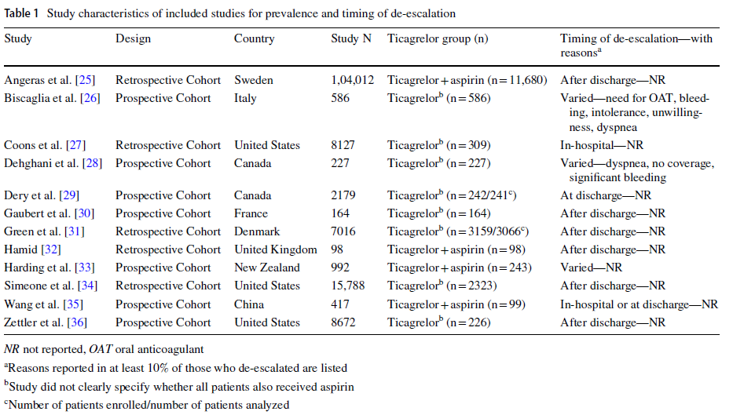
Materials and methods (1) – Study characteristics of included studies for prevalence and timing of de-escalation
Sample sizes for the ticagrelor group varied from 98 to 11,680 patients.
Where reported, mean or median age spanned from 60 to 67.7 years of age.
The proportion of females ranged from 22.5 to 36% across 11 studies reporting.
Angiolillo, D.J., Patti, G., Chan, K.T. et al. J Thromb Thrombolysis (2019). https://doi.org/10.1007/s11239-019-01860-7.
Zinc code : SAGLB.CLO.18.01.0071b Date of approval : 20 May 2019
This is for internal use only and subsequent use in the affiliates is subject to local review and approval.

Slide 41
Results – Reasons for De-escalation
The most common reasons for de-escalation (reported in at least 10%) among 586 patients with available data included need for oral anticoagulant therapy (28%), bleeding (17%), intolerance (12%), patient unwillingness (10%), and dyspnea (10%) were just reported in one study.
Angiolillo D, et al. JACC. 2018;71(11Suppl) A1200; DOI: 10.1016/S0735-1097(18)31741-8.
Zinc code : SAGLB.CLO.18.01.0071b Date of approval : 20 May 2019
This is for internal use only and subsequent use in the affiliates is subject to local review and approval.

Slide 42
Prevalence of de-escalation – Conclusions
Our analysis showed that it is not infrequent for ACS patients to de-escalate to clopidogrel therapy following initial treatment with ticagrelor (pooled prevalence rate of 19.8%).
We observed a higher prevalence rate of de-escalation occurring in-hospital or at discharge than after hospital discharge (23.7% vs. 15.8%)
Zinc code : SAGLB.CLO.18.01.0071b Date of approval : 20 May 2019
This is for internal use only and subsequent use in the affiliates is subject to local review and approval.

Slide 43
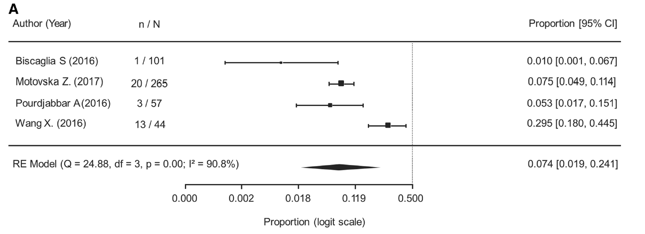
Results – All Bleeding
Results of the meta-analysis showed the rate of bleeding events were 7.4% (95% CI 1.9–24.1%)for all bleeding (major and minor) during a mean follow-up of 7.8 months .
Angiolillo, D.J., Patti, G., Chan, K.T. et al. J Thromb Thrombolysis (2019). https://doi.org/10.1007/s11239-019-01860-7.
Zinc code : SAGLB.CLO.18.01.0071b Date of approval : 20 May 2019
This is for internal use only and subsequent use in the affiliates is subject to local review and approval.

Slide 44
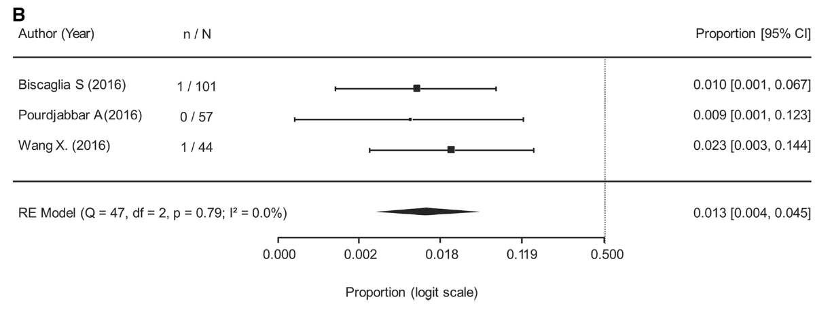
Results – Major Bleeding
Results of the meta-analysis showed the rate of major bleeding was 1.3% (95% CI 0.4–4.5%) during a mean follow-up of 6.3 months
Angiolillo, D.J., Patti, G., Chan, K.T. et al. J Thromb Thrombolysis (2019). https://doi.org/10.1007/s11239-019-01860-7.
Zinc code : SAGLB.CLO.18.01.0071b Date of approval : 20 May 2019
This is for internal use only and subsequent use in the affiliates is subject to local review and approval.

Slide 45
Results – Stroke and Stent Thrombosis
There were zero cases of stroke reported in 252 patients and one case of stent thrombosis reported in 202 patients who had available data following de-escalation from ticagrelor to clopidogrel.
Angiolillo, D.J., Patti, G., Chan, K.T. et al. J Thromb Thrombolysis (2019). https://doi.org/10.1007/s11239-019-01860-7.
Zinc code : SAGLB.CLO.18.01.0071b Date of approval : 20 May 2019
This is for internal use only and subsequent use in the affiliates is subject to local review and approval.

Slide 46
Clinical outcomes – Conclusions
Results of the pooled analysis showed that cardiovascular events occurred at a rate of 2.1% for MACE, 1.6% for cardiovascular mortality, and 4.5% for myocardial infarction in patients following de-escalation from ticagrelor to clopidogrel.
Reported cases of stroke and stent thrombosis were rare in studies.
All bleeding occurred at a rate of 3.3% and major bleeding at a rate of 1.1%.
Although rates of major cardiovascular and bleeding events in this analysis were generally low, the profile of patients suitable for de-escalation, the impact of de-escalation on adverse clinical outcomes and how this is affected by the timing after index ACS warrants further large-scale investigation.
Angiolillo, D.J., Patti, G., Chan, K.T. et al. J Thromb Thrombolysis (2019). https://doi.org/10.1007/s11239-019-01860-7.
MACE: Major adverse cardiovascular event
Zinc code : SAGLB.CLO.18.01.0071b Date of approval : 20 May 2019
This is for internal use only and subsequent use in the affiliates is subject to local review and approval.

Slide 47
Overall Conclusion
The analysis showed that rates of cardiovascular outcomes were generally low following de-escalation. However, further large-scale investigations are needed to appropriately examine the clinical implications of de-escalation on the risk of recurrent ischemic events and bleeding risk, as well as the appropriate timing to de-escalate patients in whom switching occurs.
Angiolillo, D.J., Patti, G., Chan, K.T. et al. J Thromb Thrombolysis (2019). https://doi.org/10.1007/s11239-019-01860-7.
MACE: Major adverse cardiovascular event
Zinc code : SAGLB.CLO.18.01.0071b Date of approval : 20 May 2019
This is for internal use only and subsequent use in the affiliates is subject to local review and approval.

Slide 48
Benefit of switched dual antiplatelet therapy after acute coronary syndrome
The TOPIC
DAPT After ACS
TOPIC: Timing Of Platelet Inhibition after acute Coronary Syndrome
DAPT: dual anti-platelet therapy, ACS: acute coronary syndrome
Cuisset T. Eur Heart Journal. 2017;38(41):3070-3078.
Zinc code : SAGLB.CLO.18.01.0071b Date of approval : 20 May 2019
This is for internal use only and subsequent use in the affiliates is subject to local review and approval.
Notes:
Let us look into the study Benefit of Switched Dual Antiplatelet Therapy After Acute Coronary Syndrome: The TOPIC (Timing Of Platelet Inhibition after acute Coronary Syndrome) Randomized Study by Cuisset et al.
Reference
Cuisset T, Deharo P, Quilici J, et al. Benefit of switching dual antiplatelet therapy after acute coronary syndrome: the TOPIC (timing of platelet inhibition after acute coronary syndrome) randomized study. Eur Heart Journal. 2017;38(41):3070-3078.

Slide 49
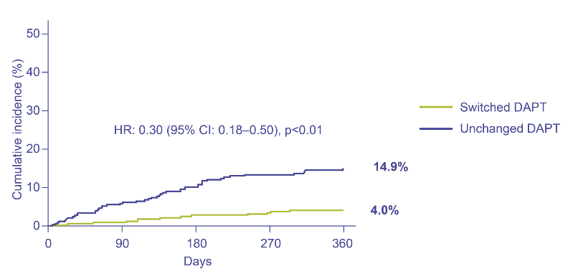
BARC Bleedings ≥2
Higher rate of BARC bleeding ≥2 with unchanged DAPT
Cuisset T, et al. Eur Heart Journal. 2017;38(41):3070-3078.
BARC: Bleeding Academic Research Consortium , HR: hazard ratio, DAPT: dual anti-platelet therapy
Zinc code : SAGLB.CLO.18.01.0071b Date of approval : 20 May 2019
This is for internal use only and subsequent use in the affiliates is subject to local review and approval.
Notes:
Bleeding events defined as BARC >2 occurred in 13 (4.0%) patients in the switched DAPT group and in 48 patients (14.9%) in the unchanged DAPT group (HR [95% CI]: 0.30 [0.18–0.50]; p<0.01). Hence, a higher rate of BARC bleeding ≥2 was seen with unchanged DAPT.
Reference
Cuisset T, Deharo P, Quilici J, et al. Benefit of switching dual antiplatelet therapy after acute coronary syndrome: The TOPIC (timing of platelet inhibition after acute coronary syndrome) randomized study. Eur Heart Journal. 2017;38(41):3070-3078.

Slide 50
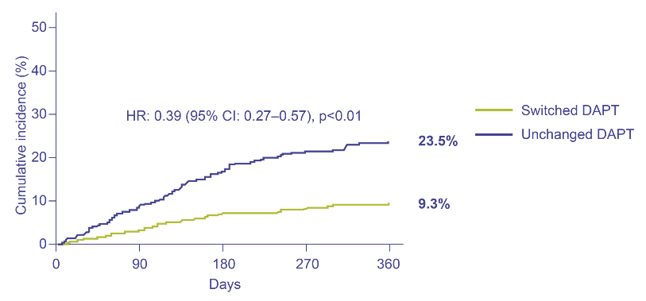
All BARC Bleedings
Higher rate of all BARC bleeding with unchanged DAPT
Cuisset T, et al. Eur Heart Journal. 2017;38(41):3070-3078.
BARC: Bleeding Academic Research Consortium , HR: hazard ratio, DAPT: dual anti-platelet therapy
Zinc code : SAGLB.CLO.18.01.0071b Date of approval : 20 May 2019
This is for internal use only and subsequent use in the affiliates is subject to local review and approval.
Notes:
Bleeding events defined as all BARC occurred in 30 (9.3%) patients in the switched DAPT group and in 76 (23.5%) patients in the unchanged DAPT group (HR [95% CI]: 0.39 [0.27–0.57], p<0.01). Hence, a higher rate of all BARC bleeding was observed with unchanged DAPT.
Reference
Cuisset T, Deharo P, Quilici J, et al. Benefit of switching dual antiplatelet therapy after acute coronary syndrome: the TOPIC (timing of platelet inhibition after acute coronary syndrome) randomized study. Eur Heart Journal. 2017;38(41):3070-3078.

Slide 51
Endpoints
ENDPOINTS | Switched DAPT, n (%) (n=322) | Unchanged DAPT (n=323) | HR (95%IC) | p-value
Net clinical benefit | 43 (13.4) | 85 (26.3) | 0.48 (0.34–0.68) | <0.01
Any ischaemic event | 30 (9.3) | 37 (11.5) | 0.48 (0.34–0.68 | 0.36
Cardiovascular Death | 1 (0.3) | 4 (1.2) | 0.30 (0.05–1.73) | 0.18
Unplanned revascularisation | 28 (8.7) | 30 (9.3) | 0.93 (0.56–1.55) | 0.78
Stent thrombosis | 4 (1.2) | 3 (0.9) | 1.34 (0.30–6.0) | 0.72
Stroke | 1 (0.3) | 3 (0.9) | 0.37 (0.05–2.60) | 0.32
All bleedings | 30 (9.3) | 76 (23.5) | 0.39 (0.27–0.57) | <0.01
BARC bleedings ≥ 2 | 13 (4) | 48 (14.9) | 0.30 (0.18–0.50) | <0.01
TIMI major | 1 (0.3) | 4 (1.2) | 0.30 (0.05–1.73) | 0.18
TIMI minor | 9 (2.8) | 26 (8) | 0.37 (0.19–0.71) | <0.01
TIMI minimal | 20 (6.2) | 46 (14.2) | 0.44 (0.27–0.71) | <0.01
Cuisset T, et al. Eur Heart Journal. 2017;38(41):3070-3078.
BARC: Bleeding Academic Research Consortium, TIMI: Thrombolysis in Myocardial Infarction
Zinc code : SAGLB.CLO.18.01.0071b Date of approval : 20 May 2019
This is for internal use only and subsequent use in the affiliates is subject to local review and approval.
Notes:
The endpoints at first year have been displayed on the screen. A total of 28 (8.7%) patients in the switched DAPT group and 30 (9.3%) in the unchanged DAPT group underwent unplanned revascularisation at 1 year (HR [95% CI]: 0.93 [0.56–1.55]; p=0.78); one patient in the switched DAPT group and three patients in the unchanged DAPT group had a stroke event at 1 year (HR [95% CI]: 0.37 [0.05–2.6]; p= 0.32); one patient in the switched DAPT group and four patients in the unchanged DAPT group had died from a cardiovascular cause at 1 year (HR [95% CI]: 0.30 [0.05–1.73]; p=0.18).
Reference
Cuisset T, Deharo P, Quilici J, et al. Benefit of switching dual antiplatelet therapy after acute coronary syndrome: the TOPIC (timing of platelet inhibition after acute coronary syndrome) randomized study. Eur Heart Journal. 2017;38(41):3070-3078.

Slide 52
Conclusion
In patients without adverse event 1 month after stented ACS, a switched DAPT is superior to an unchanged DAPT strategy to prevent bleedings without an increased risk of ischaemic events.
Cuisset T, et al. Eur Heart Journal. 2017;38(41):3070-3078.
ACS: acute coronary syndrome, DAPT: dual anti-platelet therapy
Zinc code : SAGLB.CLO.18.01.0071b Date of approval : 20 May 2019
This is for internal use only and subsequent use in the affiliates is subject to local review and approval.
Notes:
Thus, in conclusion, the study observed that in patients without adverse event 1 month after stented ACS, a switched DAPT is superior to an unchanged DAPT strategy to prevent bleedings without an increased risk of ischaemic events.
Reference
Cuisset T, Deharo P, Quilici J, et al. Benefit of switching dual antiplatelet therapy after acute coronary syndrome: The TOPIC (timing of platelet inhibition after acute coronary syndrome) randomized study. Eur Heart Journal. 2017;38(41):3070-3078.

Slide 53
TOPIC: Limitations Regarding the Design
Open-label, single-centre trial, envelope system of randomisation, telephone-based follow-up
Internal event adjudication
Majority of the included patients (60%) had unstable angina (% not precise) and NSTEMI patients
Number of patients lost to follow-up plus those crossing to the other treatment strategy arm exceeds the total number of many of the individual endpoints
Ischaemic events:
Very low number of ischaemic events
Recurrent MIs not leading to revascularisation were not part of the primary endpoint
Not reported: Percentage intervention because of a new spontaneous MI, nor the number of MIs itself
Bleeding events:
Low number of TIMI major bleeding complications
Benefit mainly driven by fewer non-major bleedings
In some patients (n=?), 10 mg of prasugrel was used without a reduced dose in the elderly individuals. Also, it is unclear as to how many of these patients contributed to the total number of bleeding complications
Sinnaeve P, et al. Eur Heart Journal. 2017;38(41):3079-3081.
NSTEMI: Non-ST-elevation myocardial infarction; MI: Myocardial infarction; TIMI: Thrombolysis in myocardial infarction.
Zinc code : SAGLB.CLO.18.01.0071b Date of approval : 20 May 2019
This is for internal use only and subsequent use in the affiliates is subject to local review and approval.
Notes:
The limitations of the TOPIC study are that it was an open-label single-centre trial, envelope system of randomisation, telephone-based follow-up and had an internal event adjudication. Majority of the included patients (60%): unstable angina (% not precise) and NSTEMI patients and the number of patients lost to follow-up plus those crossing to the other treatment strategy arm, exceeds the total number of many of the individual endpoints. In addition, the study had a very a low number of ischaemic events. Recurrent MIs not leading to revascularisation were not part of the primary endpoint, and the percentage intervention was not reported because of a new spontaneous MI, nor the number of MIs itself. The study also had a low number of TIMI major bleeding complications. The study benefits are mainly driven by fewer non-major bleedings. Moreover, in some patients, 10 mg of prasugrel was used without a reduced dose in the elderly individuals. Also, it is unclear as to how many of these patients contributed to the total number of bleeding complications.
Reference
Sinnaeve P, Van de Werf F. Clopidogrel instead of prasugrel or ticagrelor after 1 month in stabilized ACS patients: Back to square one for DAPT?. Eur Heart Journal. 2017;38(41):3079-3081.

Slide 54
Gastrointestinal bleeding when using oral anticoagulation
There are no randomized data on restarting medication after gastrointestinal bleeding.
The meta-analysis of Chai-Adisaksopha et al. examined the benefit and risks of resuming anticoagulant therapy following gastrointestinal bleeding
Three studies were selected, including patients using warfarin for various reasons (AF, deep vein thrombosis, pulmonary embolism or prosthetic heart valve), of which 17–83% also used anti-platelet therapy

Slide 55
Resumption of warfarin (in 53% of patients) was associated with a significant reduction in thromboembolic events 9.9% versus 16.4% (hazard ratio [HR] 0.68; 95% confidence interval [CI] 0.52–0.88; p= 0.004) and mortality 24.6% versus 39.2% (HR 0.76; 95% CI 0.66–0.88; p= 0.0002)
However, a numerically increased rate of recurrent gastrointestinal bleeding was observed in patients resuming warfarin (10.1% vs 5.5%, HR 1.20; 95% CI 0.97–1.48; p= 0.10)

Slide 56
This risk was significantly higher when restarting warfarin within 7 days compared with restarting later
Accordingly, the European Society of Gastrointestinal Endoscopy (ESGE) guideline recommends in patients on (N)OAC with a moderate gastrointestinal bleeding or worse, to stop (N)OAC and restart between 7–15 days after the gastrointestinal bleeding event
Patients with a very high thrombotic risk, e.g. mechanical heart valve, cardiac assist device, CHA2DS2-VASc score ≥4 may benefit from earlier (first week) resumption

Slide 57
The aforementioned studies all have an observational design and are, therefore, subject to bias through confounding by indication; patients who did not restart OAC had more severe bleeding events and were older compared with restarters
Specific data regarding restarting NOAC after gastrointestinal bleeding is lacking. Therefore, it seems reasonable to extrapolate data regarding warfarin to the NOACs, keeping in mind the faster therapeutic onset of NOACs compared with warfarin
The four phase III trials comparing the different NOACs with warfarin, showed an increased risk of gastrointestinal bleeding with rivaroxaban, high-dose dabigatran and high-dose edoxaban

Slide 58
Apixaban, low-dose dabigatran and low-dose edoxaban showed comparable gastrointestinal bleeding risk with warfarin
Therefore, patients with a gastrointestinal bleeding while using a NOAC should be considered for a lower dose or for apixaban (class IIa, LoE B)

Slide 59
Advice
● Stop OAC in patients with a moderate gastrointestinal bleeding or worse
● Restart OAC between 7–15 days after gastrointestinal bleeding
● Patients at very high thrombotic risk, e.g. mechanical heart valve, cardiac assist device, CHA2DS2-VASc score ≥4 may benefit from resumption in the first week
● Consider low-dose NOAC or apixaban in patients with NOAC-related gastrointestinal bleeding (class IIa, LoE B)

Slide 60
In patients on aspirin or DAPT for secondary prevention with upper gastrointestinal bleeding, continue aspirin or DAPT if endoscopy shows no active bleeding
● Consider a three-day interruption of aspirin in patients with active bleeding by endoscopy (strong recommendation, moderate quality evidence), in case of DAPT, continue the P2Y12 inhibitor and interrupt aspirin for three days

Slide 61
Advice
● Withhold OAC if intracranial hemorrhage occurred while adequately dosed, in case of uncontrolled hypertension, if the bleeding is located cortically, if there are multiple microbleeds (>10) or if DAPT is needed
● Reinitiate OAC if intracranial hemorrhage occurred on VKA or in the setting of overdose, if the bleeding was traumatic or has a treatable cause, if the bleeding is located in the basal ganglia, if the white matter lesions are mild, in case of removed subdural hematoma or clipped/ coiled aneurysm
Switch to a NOAC after intracranial haemorrhage (class IIb, LoE B)

Slide 62
Aspirin for secondary prevention should be continued in patients with lower gastrointestinal bleeding.
● In patients on DAPT, the P2Y12 inhibitor should be interrupted for 7 days and aspirin should be continued unless the patient had ACS within 90 days or coronary stent within 30 days (strong recommendation, low quality evidence)
● Consider in patients on DAPT to shorten the duration and to switch to DAPT with aspirin and clopidogrel
● Start with intravenous PPI in case of upper gastrointestinal bleeding and continue with oral PPI after discharge when antiplatelet therapy is reinitiated, consider oral PPI when OAC is reinitiated

Slide 63
Thank You

Slide 64
Mild Bleeding With TT
In case of triple therapy (OAC and DAPT), downgrading to dual therapy (OAC and clopidogrel) should be considered
Patients on VKA with a mild bleeding event are advised to postpone the next dose until an international normalized ratio (INR) <2, patients on NOACs are advised to skip one dose

Slide 65
Moderate bleeding on TT
Both the ESC DAPT and AF guideline recommend discontinuing OAC, whereby VKA could be reversed, until the bleeding is stopped, unless the patient is at very high thrombotic risk (mechanical heart valve, cardiac assist device, CHA2DS2-VASc [Congestive heart failure, Hypertension, Age ≥75 [doubled], Diabetes, prior Stroke [doubled]—Vascular disease, Age 65–74, Sex category] score ≥4)

Slide 66
Moderate bleeding on TT
For patients on VKA, vitamin K 5–10mg intravenously should be considered, bearing in mind it has a slow onset (at least 4–6 hours)
In patients with a NOAC-related bleeding, time is the most important antidote, with a plasma half-life of ~12 hours.
Therefore, it is important to inquire about the last dose of NOAC intake and consider factors influencing plasma concentration such as renal function

Slide 67
Charcoal could be administered if the last NOAC intake was within 2–4 hours and dialysis in patients taking dabigatran
A moderate bleeding may require blood transfusions and fluid replacement in addition to specific treatment to stop the bleeding (endoscopic or surgical hemostasis)
According to the guidelines, OAC should be reinitiated within one week, taking into account the lowest acceptable target INR or, in case of NOAC, the lowest effective dose
Patients on triple therapy should be considered for dual therapy with OAC and clopidogrel

Slide 68
The Dutch guideline for antithrombotic management advises against desamino-D-arginine vasopressin or desmopressin because of the relative contra-indication for patients with coronary artery disease
In patients with a severe bleeding on OAC, stopping and reversing OAC is indicated, unless the patient has an excessive thrombotic risk (mechanical heart valve in mitral position, cardiac assist device)

Slide 69
For VKAs the combination of fresh frozen plasma with four factors prothrombin complex concentrates (4F-PCC; 25–50U/kg) should be considered (class IIa, LoE C)
Both are faster in antagonizing VKA compared with vitamin K
4F-PCC may also be administered in patients on NOACs when a specific antidote is not available (class IIa, LoE C)
However, PCCs increase the risk of thromboembolic events (>1%)
Patients with a bleeding on dabigatran could be treated with idarucizumab 5mg intravenously which antagonizes dabigatran within 5 minutes, without procoagulant activity

Slide 70
RE-VERSE AD examined the reversal effects of idarucizumab in 301 patients with uncontrolled or life-threatening bleeding, of whom 96% used dabigatran because of AF
The median time to hemostasis after idarucizumab was 2.5 hours in patients without intracranial hemorrhage.
Furthermore, antithrombotic treatment (anticoagulant or antiplatelet drugs) was restarted in 73% after a mean of 13 days of which 23% restarted within 3 days
This is in accordance with the DAPT guideline which advises to reinitiate treatment within one week
Pollack CV Jr, Reilly PA, van Ryn J, et al. Idarucizumab for dabigatran reversal—full cohort analysis. N Engl J Med. 2017;377(5): 431–41.

Slide 71
Restarting VKA is advised within one week after the bleeding, dosing should be aimed on the lowest acceptable target INR and NOAC should be given in the lowest effective dose

Slide 72
Timing of resumption after intracranial hemorrhage
In the largest included study (n= 759), the median time to restart was 24 days, however, only patients with AF were included
The meta-analysis showed equal recurrence of intracranial hemorrhage or hematoma expansion in both groups [RR 0.84; 95% CI 0.47–1.51; p= 0.56], but thromboembolic events were significantly lower in patients restarting antiplatelet therapy [RR 0.61; 95% CI 0.48–0.79; p< 0.01]
Nielsen PB, Larsen TB, Skjoth F, et al. Restarting anticoagulant treatment after Intracranial hemorrhage in patients with atrial fibrillation and the impact on recurrent stroke, mortality, and bleeding: a nationwide cohort study.
Circulation. 2015;132(6):517–25.

Slide 73
One study from the meta-analysis included 109 Chinese patients with a first-time aspirin-related primary intracerebral hemorrhage surviving >90 days after admission
All patients used aspirin for secondary prevention
After intracerebral hemorrhage, 19% restarted aspirin

Slide 74
Timing Of Antiplatelet Resumption After Intracranial Hemorrhage
A systolic blood pressure of >140mmHg and cerebral amyloid angiopathy were independent predictors of recurrent intracerebral hemorrhage.

Slide 75
The largest RCT addressing restrictive versus liberal transfusion in ischemic heart disease patients included 838 patients, admitted to the intensive care unit, with hemoglobin levels of 5.5mmol/L or less, without active bleeding or chronic anemia
Of these, 257 had ischemic heart disease, 111 received restrictive and 146 liberal transfusion
In the total study population, a restrictive red-cell transfusion (<4.5mmol/L) proved non-inferior to a liberal transfusion (<6mmol/L)
Transfusion Requirements in Critical Care Investigators, Canadian Critical Care Trials Group, Hebert PC, Wells G, Blajchman MA, et al. A multicenter, randomized, controlled clinical trial of transfusion requirements in critical care. N Engl J Med. 1999;340(6):409–17.

Slide 76
However, subgroup analysis of patients with ischemic heart disease showed a nonsignificant decrease in overall survival in the restrictive transfusion group
The authors conclude that patients with ACS might not benefit from the restrictive transfusion strategy. A smaller RCT, including 110 patients with symptomatic coronary artery disease allocated patients to a restrictive (<5mmol/L) or liberal (<6mmol/L) strategy and found also a trend towards fewer major cardiac events and deaths in the liberal transfusion group

Slide 77
Advice
● Treat anemic ACS patients according to a more liberal transfusion strategy (<6mmol/L)

Slide 78
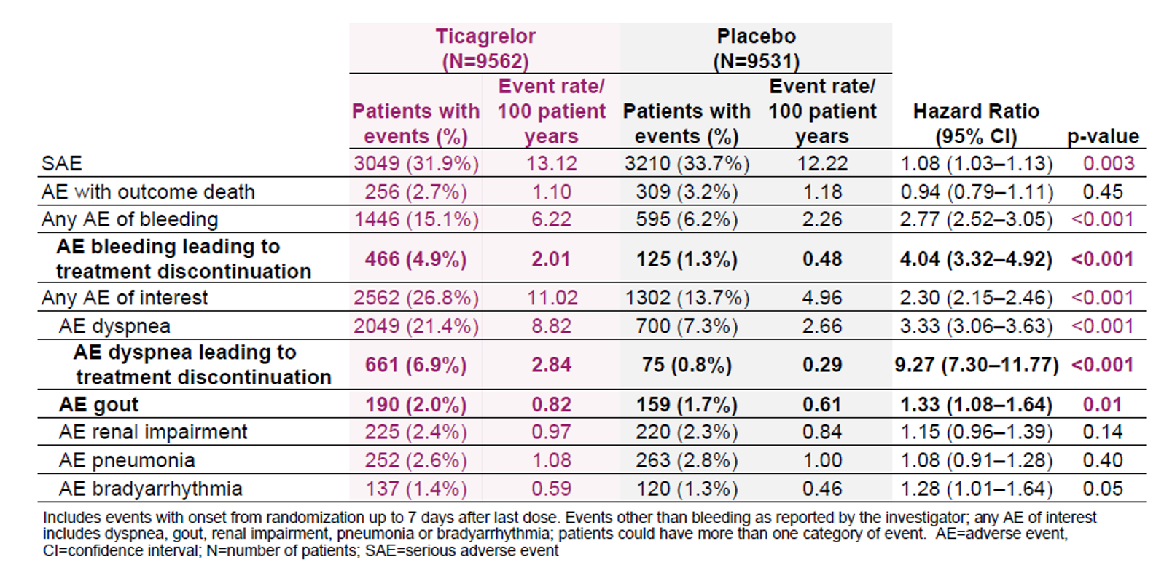
Safety Outcomes

Slide 79
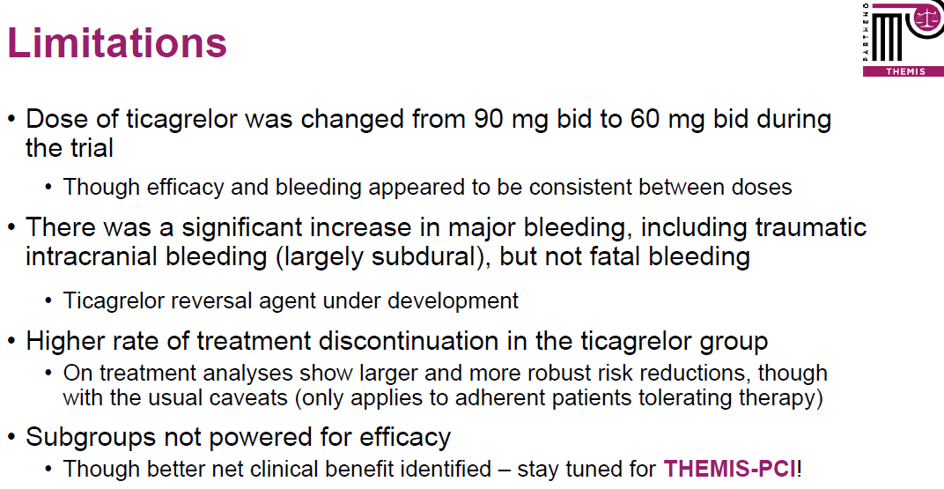

Slide 80
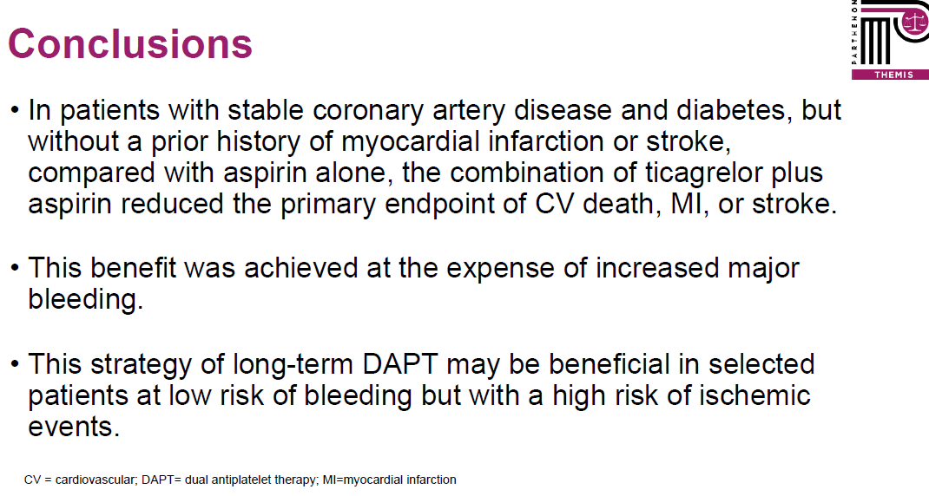
THEMIS Conclusion

