Slide 1

Antiplatelet De-escalation in the Management of ACS and PCI
ACS: Acute coronary syndrome; PCI: Percutaneous coronary intervention.
Notes:
Welcome to the Sanofi module on Antiplatelet De-escalation in the Management of Acute Coronary Syndrome and Percutaneous Coronary Intervention.

Slide 2
Chapters
Current guidelines
Context
Background
Pharmacodynamic studies looking into de-escalation
Real-life studies looking into de-escalation
Randomised clinical studies looking into de-escalation
Conclusion and perspectives
Notes:
The module includes:
Current guidelines
Context
Background
Pharmacodynamic studies looking into de-escalation
Real-life studies looking into de-escalation
Randomised clinical studies looking into de-escalation
Conclusion and perspectives

Slide 3
CURRENT GUIDELINES
Notes:
Let us discuss current guidelines on dual antiplatelet therapy (DAPT) in ACS patients.

Slide 4
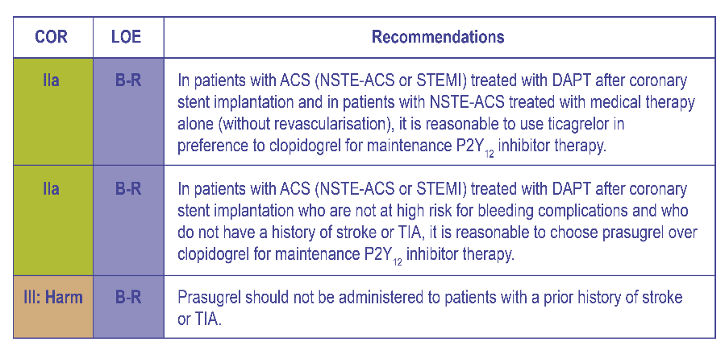
US Guidelines on Specific P2Y₁₂ Inhibitors in ACS
AHA/ACC 2016 focused update on DAPT duration
AHA/ACC: American Heart Association/ American College of Cardiology; ACS: Acute coronary syndrome; NSTE-ACS: Non-ST-elevation acute coronary syndrome; DAPT: Dual anti-platelet therapy; STEMI: ST-elevation myocardial infarction; TIA: Transient ischemic attack.
Levine GN et al. Circulation. 2016;134:e123-55
Notes:
The American College of Cardiology/American Heart Association Task Force suggests that it is practical to use ticagrelor instead of clopidogrel for maintenance P2Y12 inhibitor therapy in patients with ACS treated with dual antiplatelet therapy (DAPT) after coronary stent implantation and in patients with NSTE-ACS treated with medical therapy alone. In addition, ticagrelor is used over clopidogrel for maintenance P2Y12 inhibitor therapy in patients with ACS (NSTE-ACS or STEMI) treated with DAPT after coronary stent implantation who are not at high risk for bleeding complications and who do not have a history of stroke or transient ischaemic attack (TIA). Lastly, Prasugrel is contraindicated in patients with a prior history of stroke or TIA.
Reference
Levine G, Bates E, Bittl J, et al. 2016 ACC/AHA guideline focused update on duration of dual antiplatelet therapy in patients with coronary artery disease: A report of the American College of Cardiology/American Heart Association Task Force on Clinical Practice Guidelines. Circulation. 2016;134(10):e123-e155.

Slide 5
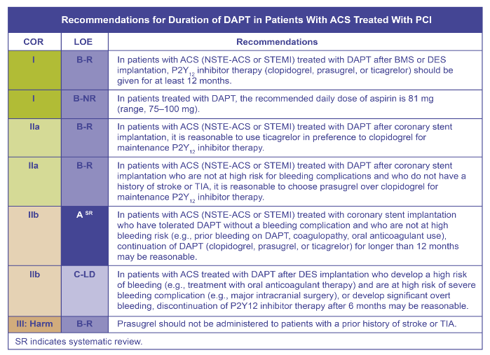
US Guidelines: Optimal Timing/Duration of DAPT
AHA/ACC 2016 focused update on DAPT duration
AHA/ACC: American Heart Association/ American College of Cardiology; DAPT: Dual anti-platelet therapy; ACS: Acute coronary syndrome; BMS: Bare metal stent; DES: Drug-eluting stent; SIHD: Stable ischaemic heart disease, PCI: Percutaneous coronary intervention; NSTE-ACS: Non-ST-elevation acute coronary syndrome; STEMI: ST-elevation myocardial infarction; TIA: Transient ischaemic attack.
Levine GN, et al. Circulation. 2016;134:e123-155.
Zinc code : SAGLB.CLO.18.01.0071b Date of approval : 20 May 2019
This is for internal use only and subsequent use in the affiliates is subject to local review and approval.
Notes:
Furthermore, the guidelines elaborate on the optimal timing/duration of DAPT in patients with ACS treated with PCI.
Reference
Levine G, Bates E, Bittl J, et al. 2016 ACC/AHA guideline focused update on duration of dual antiplatelet therapy in patients with coronary artery disease: A report of the American College of Cardiology/American Heart Association Task Force on Clinical Practice Guidelines. Circulation. 2016;134(10):e123-e155.

Slide 6
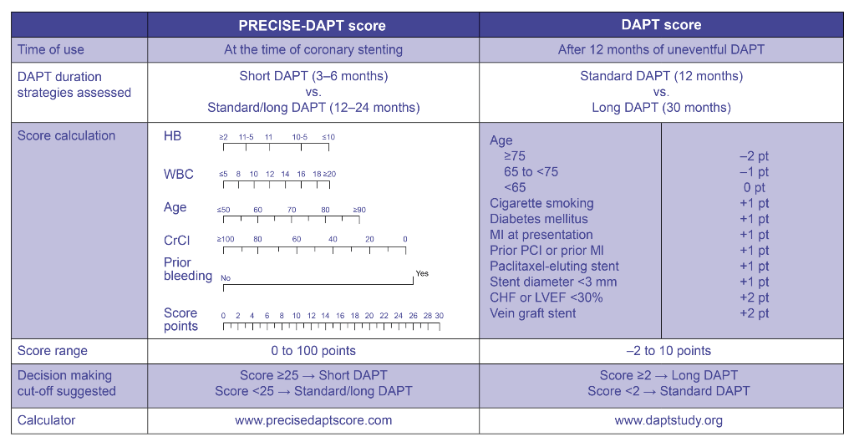
PRECISE-DAPT Score for Duration of Therapy
PRECISE-DAPT: PREdicting bleeding Complications In patients undergoing Stent implantation and subsEquent Dual Anti Platelet Therapy; HB: haemoglobin; WBC: white blood cells, CrCl: creatinine clearance; LVEF: Left ventricular ejection fraction; PCI: Percutaneous coronary intervention; MI: Myocardial infarction; CHF: Chronic heart failure.
Valgimigli M, et al. Eur Heart Journal. 2017. doi: 10.1093/eurheartj/ehx419.
Notes:
Risk scores might be helpful to maximise ischaemic protection and minimise bleeding risks in the tailoring of DAPT. However, the application of these risk scores to decide upon DAPT period is difficult, considering the there are limited data exploring this topic. Nevertheless, the use of risk scores that were primarily formulated to direct and support decision making on DAPT duration should be prioritised over other risk scores, displayed on screen.
Reference
Valgimigli M, Bueno H, Byrne R, et al. 2017 ESC focused update on dual antiplatelet therapy in coronary artery disease developed in collaboration with EACTS: The Task Force for dual antiplatelet therapy in coronary artery disease of the European Society of Cardiology (ESC) and of the European Association for Cardio-Thoracic Surgery (EACTS). Eur Heart Journal. 2017. doi: 10.1093/eurheartj/ehx419.

Slide 7
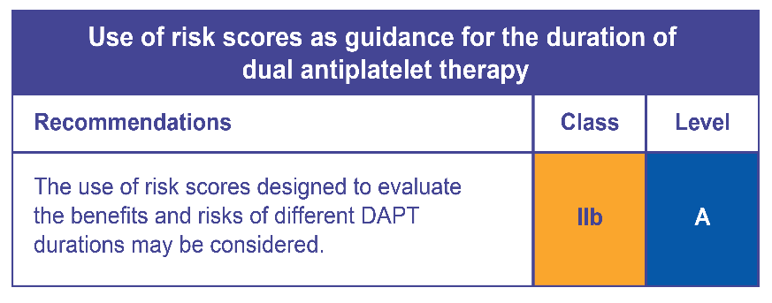
PRECISE-DAPT Score Recommendation
PRECISE-DAPT: PREdicting bleeding Complications In patients undergoing Stent implantation and subsEquent Dual Anti Platelet Therapy.
Valgimigli M, et al. Eur Heart Journal. 2017. doi: 10.1093/eurheartj/ehx419.
Notes:
The PREdicting bleeding Complications In patients undergoing Stent implantation and subsEquent Dual AntiPlatelet Therapy (PRECISE-DAPT) collaborative study score demonstrated improved performance and outcomes. A short-term treatment of less than12 months in patients with high bleeding risk can prevent bleeding complications. Moreover, tolerant patients with a non-high bleeding risk can traditionally receive a standard (12 months) or prolonged (>12 months) therapeutic intervention. It is important to note that none of these risk prediction models have been evaluated or confirmed by randomised control trials (RCTs) and, hence, their application to improve patient outcomes remains indecisive.
Reference
Valgimigli M, Bueno H, Byrne R, et al. 2017 ESC focused update on dual antiplatelet therapy in coronary artery disease developed in collaboration with EACTS: The Task Force for dual antiplatelet therapy in coronary artery disease of the European Society of Cardiology (ESC) and of the European Association for Cardio-Thoracic Surgery (EACTS). Eur Heart Journal. 2017. doi: 10.1093/eurheartj/ehx419.

Slide 8
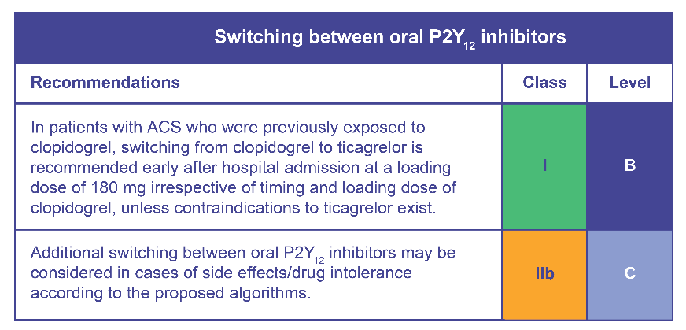
Switching Among P2Y₁₂ Agents
Valgimigli M, et al. Eur Heart Journal. 2017. doi: 10.1093/eurheartj/ehx419.
ACS: acute coronary syndrome
Notes:
While switching drugs and doses, it is important to keep in mind the differences in the pharmacology of P2Y12 receptor inhibitors with regard to their binding site, half-life and speed of onset and offset of action. If patients have been receiving clopidogrel, a loading dose of 180 mg is recommended. In case of contradiction, ticagrelor is recommended. Moreover, switching between oral P2Y12 inhibitors may be acceptable in cases of side effects and drug intolerance.
Reference
Valgimigli M, Bueno H, Byrne R, et al. 2017 ESC focused update on dual antiplatelet therapy in coronary artery disease developed in collaboration with EACTS: The Task Force for dual antiplatelet therapy in coronary artery disease of the European Society of Cardiology (ESC) and of the European Association for Cardio-Thoracic Surgery (EACTS). Eur Heart Journal. 2017. doi: 10.1093/eurheartj/ehx419.

Slide 9
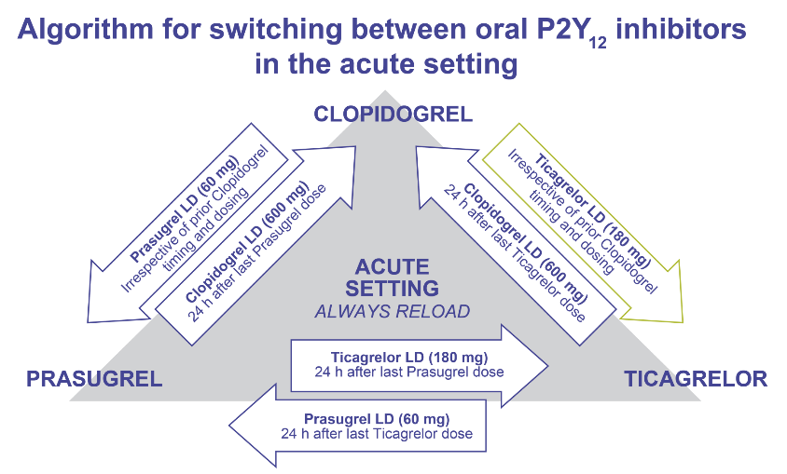
Recommendation on Switching in an Acute Setting
Valgimigli M, et al. Eur Heart Journal. 2017. doi: 10.1093/eurheartj/ehx419.
LD: Loading dose.
Notes:
Therefore, an algorithm for switching between oral P2Y₁₂ receptors in an acute setting based on pharmacodynamic studies is provided on the screen. Acute setting is considered as a switch during hospitalisation. The colour-coding refers to the Classes of Recommendations (green = Class I; orange = Class IIb). The green arrow from clopidogrel to ticagrelor highlights the availability of outcome data in ACS. No outcome data (orange arrows) are available for the rest of the switching algorithms.
Reference
Valgimigli M, Bueno H, Byrne R, et al. 2017 ESC focused update on dual antiplatelet therapy in coronary artery disease developed in collaboration with EACTS: The Task Force for dual antiplatelet therapy in coronary artery disease of the European Society of Cardiology (ESC) and of the European Association for Cardio-Thoracic Surgery (EACTS). Eur Heart Journal. 2017. doi: 10.1093/eurheartj/ehx419.

Slide 10
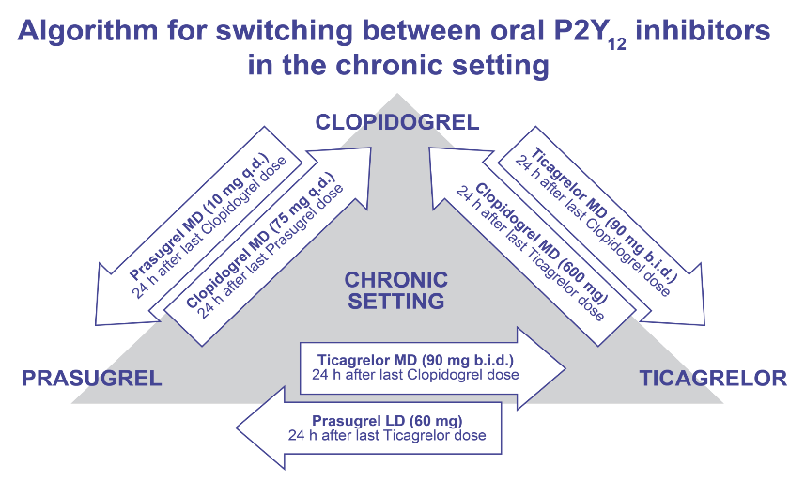
Recommendation on Switching in a Chronic Setting
Valgimigli M, et al. Eur Heart Journal. 2017. doi: 10.1093/eurheartj/ehx419.
LD: Loading dose; MD: Maintenance dose.
Notes:
An algorithm for switching between oral P2Y₁₂ receptors in a chronic setting based on pharmacodynamic studies is provided on the screen. The colour-coding refers to the Classes of Recommendations (orange = Class IIb). No outcome data (orange arrows) are available for all the switching algorithms.
Reference
Valgimigli M, Bueno H, Byrne R, et al. 2017 ESC focused update on dual antiplatelet therapy in coronary artery disease developed in collaboration with EACTS: The Task Force for dual antiplatelet therapy in coronary artery disease of the European Society of Cardiology (ESC) and of the European Association for Cardio-Thoracic Surgery (EACTS). Eur Heart Journal. 2017. doi: 10.1093/eurheartj/ehx419.

Slide 11
CONTEXT AND BACKGROUND
Notes:
Now let us discuss the context and background for de-escalation with DAPT.

Slide 12
Switching From a New P2Y₁₂ Inhibitor to Clopidogrel
New P2Y₁₂ inhibitors have been endorsed as antiplatelets of choice in patients with ACS
Many physicians limit treatment duration of new P2Y₁₂ inhibitors to the early phases following an ACS, due to
  Reduced cost of clopidogrel
  Concerns about increased bleeding or following a bleeding event
  Safety concerns (e.g., dyspnoea)
  The need for concomitant oral anticoagulation
Switching may be associated with a reduction in platelet-inhibitory effects and an increase in platelet reactivity, but it may also be associated with lower potential for bleeding complications
ACS: acute coronary syndrome
Notes:
Newer P2Y₁₂ inhibitors have been allowed as the antiplatelets of choice in patients with ACS. However, many physicians limit treatment duration of new P2Y₁₂ inhibitors to the early phases (weeks or months) following an ACS, primarily due to reduced cost of clopidogrel, concerns about increased bleeding or following a bleeding event and safety concerns (e.g., dyspnoea), and the need for concomitant oral anticoagulation. Differences in the pharmacology of P2Y₁₂ inhibitors, such as their binding sites, half-life, and speed of onset and offset of action, are important factors that might lead to drug interactions when switching between agents. Switching may be associated with a reduction in platelet-inhibitory effects and an increase in platelet reactivity; however, switching may also be associated with lower potential for bleeding complications.^{1,2,3}
References
Rollini F, Franchi F, Angiolillo D. Switching P2Y12-receptor inhibitors in patients with coronary artery disease. Nat Rev Cardiol. 2015;13(1):11-27.
De Luca L, Capranzano P, Patti G, Parodi G. Switching of platelet P2Y12 receptor inhibitors in patients with acute coronary syndromes undergoing percutaneous coronary intervention: Review of the literature and practical considerations. American Heart Journal. 2016;176:44-52.
Franchi F, Rollini F. Switching from ticagrelor to clopidogrel: New answers and further questions. Thrombosis and Haemostasis. 2016;117(2):207-208.

Slide 13

Management of ACS With an Optimal DAPT: Need of Well-Balanced Treatment
Prevent Ischaemic Outcomes Without Increasing the Risk of Minor and Severe Bleedings
Lettino M, et al. Eur J Prev Cardiol. 2017;24(3_suppl):61-70.
DAPT: dual anti-platelet therapy, ACS: acute coronary syndrome
Notes:
Management of ACS with an optimal DAPT maybe the need of the hour to support a well-balanced treatment. It helps prevent ischaemic outcomes without increasing the risk of minor and severe bleedings.
Reference
Lettino M, Leonardi S, De Maria E, Halvorsen S. Antiplatelet and antithrombotic treatment for secondary prevention in ischaemic heart disease. Eur J Prev Cardiol. 2017;24(3_suppl):61-70.

Slide 14



Concept of De-escalation: Why Is It Important?
Ischaemic/bleeding risks
Evolution after ACS
Bleeding
Thrombosis
M1
Thrombotic risk > Bleeding risk
Bleeding risk > Thrombotic risk
Cuisset T, et al. Eur Heart Journal. 2017;38(41):3070-3078.
ACS: acute coronary syndrome M1: 1 month.
Notes:
It is suggested that the danger of thromboembolism is greater than that of bleeding within 1 month after ACS stent implantation. Also, the risk of bleeding is greater after 1 month than that of thromboembolism. Therefore, patient medication cannot be fixed and should be based on a risk assessment prior to choosing a medication.
Reference
Cuisset T, Deharo P, Quilici J, et al. Benefit of switching dual antiplatelet therapy after acute coronary syndrome: The TOPIC (timing of platelet inhibition after acute coronary syndrome) randomized study. Eur Heart Journal. 2017;38(41):3070-3078.

Slide 15
Why Is This Important?
Switched DAPT post ACS following risk evolution
Aspirin + new P2Y₁₂ blockers
Risk of stent thrombosis/recurrent events
Platelet Inhibition
Aspirin + clopidogrel
Aspirin ± clopidogrel
M1
M12
Cuisset T, et al. Eur Heart Journal. 2017;38(41):3070-3078.
DAPT: dual anti-platelet therapy, ACS: acute coronary syndrome; M1: Month 1; M12: Month 12.
Notes:
Sufficient platelet inhibition is crucial to minimise the risk of recurrent ischaemic events, mainly after ACS. Dual antiplatelet therapy with aspirin and a P2Y12 inhibitor (clopidogrel, prasugrel or ticagrelor) is currently recommended following ACS for 1 year, which is known to reduce the risk of stent thrombosis/recurrent events. Hence, switching to DAPT post ACS following risk evaluation is vital.
Reference
Cuisset T, Deharo P, Quilici J, et al. Benefit of switching dual antiplatelet therapy after acute coronary syndrome: the TOPIC (timing of platelet inhibition after acute coronary syndrome) randomized study. Eur Heart Journal. 2017;38(41):3070-3078.

Slide 16
Management of ACS With New P2Y₁₂ Inhibitors
TRITON-TIMI 38
Prasugrel (60 mg LD/10 mg MD) versus Clopidogrel (300 mg LD/75 mg MD)
ACS: acute coronary syndrome; TRITON-TIMI: TRial to assess Improvement in Therapeutic Outcomes by optimizing platelet inhibition with prasugrel–Thrombolysis in Myocardial Infarction; ACS: Acute coronary syndrome; LD: Loading dose; MD: Maintenance dose.
Wiviott S, et al. New Eng J Med. 2007;357(20):2001-2015.
Notes:
The Trial to Assess Improvement in Therapeutic Outcomes by Optimizing Platelet Inhibition with Prasugrel–Thrombolysis in Myocardial
Infarction (TRITON-TIMI) conducted a study to compare prasugrel, a new thienopyridine, with clopidogrel. A total of 13,608 patients with moderate- to high-risk ACS with PCI were randomly assigned to receive prasugrel (a 60-mg loading dose and a 10-mg daily maintenance dose) or clopidogrel (a 300-mg loading dose and a 75-mg daily maintenance dose) for 6 to 15 months. The primary efficacy endpoint was death from cardiovascular causes, nonfatal myocardial infarction or nonfatal stroke. The key safety endpoint was major bleeding.
Reference
Wiviott S, Braunwald E, McCabe C, et al. Prasugrel versus clopidogrel in patients with acute coronary syndromes. New Eng J Med. 2007;357(20):2001-2015.

Slide 17
Study design
  Primary Outcome Measures : Number of Subjects Reaching the Composite Endpoint of Cardiovascular (CV) Death, Nonfatal Myocard ial Infarction (MI), or Nonfatal Stroke
ClinicalTrials.gov Identifier: NCT00097591

Slide 18
TRITON-TIMI 38: SUMMARY
Event rate at 15 months¹
PATIENTS¹
Patients with acute coronary syndromes (ACS) whose coronary anatomy was known to be suitable for percutaneous coronary intervention (PCI)
13,608 randomized; 6741 prasugrel, 6716 clopidogrel
SAFETY¹
Non–coronary artery bypass grafting (CABG)-related major bleeding: prasugrel 2.4%, clopidogrel 1.8%; p=0.03
TIMI major or minor bleeding: prasugrel 5.0%, clopidogrel 3.8%; p=0.002
p<0.001
p<0.001
Patients, %
THERAPIES¹
Prasugrel: 60 mg loading dose/10 mg once daily maintenance dose
Clopidogrel: 300 mg loading dose/75 mg once daily maintenance dose
CV, cardiovascular
CONCLUSION¹
In patients with moderate-to-high-risk ACS undergoing PCI, prasugrel treatment was associated with significantly reduced rates of ischemic events compared with clopidogrel. Use of prasugrel was associated with an increased risk of major bleeding compared with clopidogrel, including fatal bleeding
Wiviott SD, Braunwald E, McCabe CH, et al. Prasugrel versus clopidogrel in patients with acute coronary syndromes. N Engl J Med 2007;357(20):2001–15

Slide 19
Management of ACS With New P2Y₁₂ Inhibitors
PLATO
Ticagrelor (180 mg LD/90 mg b.i.d. MD) versus Clopidogrel
(300/600 mg LD/75 mg MD)
PLATO : Study of PLATelet Inhibition and Patient Outcomes
Wallentin L, et al. New Eng J Medicine. 2009;361(11):1045-1057.
ACS: Acute coronary syndrome; PLATO: The Study of Platelet Inhibition and Patient Outcomes; LD: Loading dose; MD: Maintenance dose.
Notes:
The Study of Platelet Inhibition and Patient Outcomes (PLATO) was a multicentre, double-blind, randomised trial that compared ticagrelor (180-mg loading dose, 90 mg twice daily thereafter) and clopidogrel (300- to 600-mg loading dose, 75 mg daily thereafter) for the prevention of cardiovascular events. A total of 18,624 patients were evaluated with an ACS, with or without ST-segment elevation.
PLATO- a Study of PLATelet Inhibition and Patient Outcomes
Reference
Wallentin L, Becker R, Budaj A, et al. Ticagrelor versus clopidogrel in patients with acute coronary syndromes. New Eng J Medicine. 2009;361(11):1045-1057.

Slide 20
Primary and Secondary Endpoints
Primary Outcome Measures
  Any Event From the Composite of Death From Vascular Causes, Myocardial Infarction (MI), and Stroke
  Major Bleeding Event

Slide 21
PLATO: SUMMARY
Event rate at 12 months¹
PATIENTS¹
Patients with ST-segment elevation or non–ST-segment elevation acute coronary syndromes (ACS)
18624 patients were randomized; 9333 ticagrelor, 9291 clopidogrel
SAFETY¹
Major bleeding: ticagrelor 11.6%, clopidogrel 11.2%; p=0.43
Bleeding requiring red cell transfusion: ticagrelor 8.9%, clopidogrel 8.9%; p=0.96
Fatal bleeding: ticagrelor 0.3%, clopidogrel 0.3%; p=0.66
Intracranial bleeding: ticagrelor 0.3%, clopidogrel 0.2%; p=0.06
p=0.005
Patients, %
THERAPIES¹
Ticagrelor: 180 mg loading dose/90 mg twice daily maintenance dose
Clopidogrel: 300 mg loading dose/
75 mg once daily maintenance dose
MI, myocardial infarction
*p=0.005 vs ticagrelor; ** p<0.001 vs ticagrelor
CONCLUSION¹
In patients with ACS with or without ST-segment elevation, ticagrelor treatment was associated with significantly reduced rates of death from vascular causes, MI, or stroke compared with clopidogrel. No difference in overall major bleeding was observed between treatment groups; however, use of ticagrelor was associated with an increase in the rate of non–procedure-related bleeding
Wallentin L, Becker RC, Budaj A, et al. Ticagrelor versus clopidogrel in patients with acute coronary syndromes. N Engl J Med 2009;361(11):1045–57

Slide 22
REAL-LIFE STUDIES LOOKING INTO DE-ESCALATION
Notes:
Let us now look into real-life studies on de-escalation.

Slide 23
Prevalence of Switching: Registries
Registry studies have shown that the prevalence of switching from a new P2Y₁₂ inhibitor to clopidogrel is common either during the hospital stay or at discharge
NSTEMI: Non-ST-elevation myocardial infarction; STEMI: ST-elevation myocardial infarction; ACS: Acute coronary syndrome; PCI: Percutaneous coronary intervention.
Reviewed in: Rollini F, et al. Nat Rev Cardiol. 2016;13:11-27.
Zinc code : SAGLB.CLO.18.01.0071b Date of approval : 20 May 2019
This is for internal use only and subsequent use in the affiliates is subject to local review and approval.
Notes:
As shown on the screen, registry studies have shown that the prevalence of switching from a new P2Y₁₂ inhibitor to clopidogrel is common (up to 11.5% of patients) either during the hospital stay or at discharge.
Reference
Rollini F, Franchi F, Angiolillo D. Switching P2Y12-receptor inhibitors in patients with coronary artery disease. Nat Rev Cardiol. 2015;13(1):11-27.

Slide 24
Prevalence of Switching and Outcomes: Registries/Observational Studies
Study | Population | Switching prevalence | Outcomes (exploratory)
TRANSLATE-ACS Bagai A, et al. Eur Heart J Acute Cardiovasc Care. 2015;4:499-508 | NSTEMI and STEMI n=11,999 | In-hospital switch 13.6% of patients from prasugrel/ticagrelor to clopidogrel | No increase in 6-month MACE if switched in hospital: 8.9% if switched from new agent to clopidogrel 7.6% if continued on new agent (adjusted HR, 1.06; 95% CI, 0.75–1.49)
TRANSLATE-ACS Zettler MW, et al. Am Heart J. 2017;183:62-68 | NSTEMI and STEMI n=8672 | Post-discharge switch 15.4% of patients from switched from prasugrel in 1st year after discharge 28.3% of patients from switched from ticagrelor in 1st year after discharge | No increase MACE in 30 days after switch: 0.8% if switched from prasugrel to clopidogrel 0% if switched from ticagrelor to clopidogrel 1.9% if switched from clopidogrel to new agent
SCOPE De Luca L, et al. EuroIntervention. 2017. (Epub ahead of print) | ACS undergoing PCI n=1363 | At-discharge switch 1.8% of patients from prasugrel/ticagrelor to clopidogrel Post-discharge switch (mean 42 days from discharge) 1.5% of patients from prasugrel/ticagrelor to clopidogrel | Increased likelihood of net adverse cerebrovascular events (MACE plus bleeding events) if switched to clopidogrel (OR, 5.3; 95% CI, 2.1–18.2; p=0.04), primarily because of increased risk of MI
Biscaglia S, et al. Platelets. 2016;27:484-487 | ACS undergoing PCI n=586 | 17% switched from ticagrelor to clopidogrel, median 69 days after PCI | No ischaemic events in the 10 days after switch. Higher rate of BARC-1 and BARC-2 bleeding before the switch
Wang X, et al. Eur Heart J Suppl. 2016;18(Suppl F):F19-F26 | ACS undergoing PCI n=417 | 10.6% switched from ticagrelor to clopidogrel Of these patients, 4.5% switched before PCI, 20.5% after the PCI but before discharge and 75% switched at discharge | No difference in ischemic events in switched patients versus those continued on ticagrelor (6.8% vs. 3.6%, p=0.6) Lower risk of TIMI bleeding if switched (29.5% vs. 50.0%, p=0.02)
Other observational studies have also shown switching to clopidogrel is common in clinical practice and have reported exploratory findings on outcomes
Reviewed in: Rollini F, et al. Nat Rev Cardiol. 2016;13:11-27.
BARC: Bleeding Academic Research Consortium; MACE: Major adverse cardiovascular events; OR: Odds ratio; ACS: Acute coronary syndrome; PCI: Percutaneous coronary intervention.
Zinc code : SAGLB.CLO.18.01.0071b Date of approval : 20 May 2019
This is for internal use only and subsequent use in the affiliates is subject to local review and approval.
Notes:
Observational studies have shown that patients switching to clopidogrel is a common occurrence in clinical practice, and these studies have reported exploratory findings on outcomes. Most studies have shown no increase in ischaemic events or bleeding following switching to clopidogrel from prasugrel/ticagrelor. However, the SCOPE registry reported a potential increase in MI at short-term follow-up when patients were switched to clopidogrel.
Reference
Rollini F, Franchi F, Angiolillo D. Switching P2Y12-receptor inhibitors in patients with coronary artery disease. Nat Rev Cardiol. 2015;13(1):11-27.

Slide 25
Highlights
With the availability of different oral P2Y12 receptor inhibitors, antiplatelet treatment strategies can be personalized based on individual patient risk for ischemic or bleeding complications.
Recent clinical trial evidence demonstrate that an early and guided de-escalation strategy based on platelet function testing may be considered as an alternative treatment option for patients with acute coronary syndrome.
Data from real world practice shows that non-guided de-escalation is common, although the clinical implications of this approach remain unknown.
The profile of patients suitable for de-escalation, the impact of de-escalation on adverse clinical outcomes and how this is affected by the timing after index ACS warrants further large-scale investigation.
Notes:
1. Levine GN, Bates ER, Bittl JA, et al. 2016 ACC/AHA guideline focused update on duration of dual antiplatelet therapy in patients with coronary artery disease: A report of the American College of Cardiology/American Heart Association Task Force on Clinical Practice Guidelines. Circulation. 2016;134(10):e123-55. doi:10.1161/CIR.0000000000000404.
2. Valgimigli M, Bueno H, Byrne RA, et al. 2017 ESC focused update on dual antiplatelet therapy in coronary artery disease developed in collaboration with EACTS. Eur Heart J. August 2017. doi:10.1093/eurheartj/ehx419.
3. Rollini F, Franchi F, Angiolillo DJ. Switching P2Y12-receptor inhibitors in patients with coronary artery disease. Nat Rev Cardiol. 2016;13(1):11-27. doi:10.1038/nrcardio.2015.113.
4. Angiolillo DJ, Rollini F, Storey RF, et al. International expert consensus on switching platelet P2Y12 receptor–inhibiting therapies. Circulation. 2017;136(20):1955-1975. doi:10.1161/CIRCULATIONAHA.117.031164.
5. Alexopoulos D, Xanthopoulou I, Deftereos S, et al. In-hospital switching of oral P2Y12 inhibitor treatment in patients with acute coronary syndrome undergoing percutaneous coronary intervention: prevalence, predictors and short-term outcome. Am Heart J. 2014;167(1):68-76.e2. doi:10.1016/j.ahj.2013.10.010.
6. Cuisset T, Deharo P, Quilici J, et al. Benefit of switching dual antiplatelet therapy after acute coronary syndrome: the TOPIC (timing of platelet inhibition after acute coronary syndrome) randomized study. Eur Heart J. 2017;38(41):3070-3078. doi:10.1093/eurheartj/ehx175.
7.Sibbing D, Aradi D, Jacobshagen C, et al. Guided de-escalation of antiplatelet treatment in patients with acute coronary syndrome undergoing percutaneous coronary intervention (TROPICAL-ACS): a randomised, open-label, multicentre trial. Lancet (London, England). 2017;390(10104):1747-1757. doi:10.1016/S0140-6736(17)32155-4.

Slide 26
De-Escalation from Ticagrelor to Clopidogrel in Patients with Acute Coronary Syndrome
A Systematic Review and Meta-Analysis
⁹

Slide 27
Aims
To conduct a systematic literature review and meta-analysis in order to assess :
  The prevalence rate of de-escalation from ticagrelor to clopidogrel in patients with ACS and the time at which de-escalation takes place following the index event.
  The rate of clinical outcomes (ischemic events and bleeding) following de-escalation from ticagrelor to clopidogrel in patients with ACS.
Angiolillo, D.J., Patti, G., Chan, K.T. et al. J Thromb Thrombolysis (2019). https://doi.org/10.1007/s11239-019-01860-7.
Zinc code : SAGLB.CLO.18.01.0071b Date of approval : 20 May 2019
This is for internal use only and subsequent use in the affiliates is subject to local review and approval.
Notes:
To assess the prevalence of the de-escalation from ticagrelor to clopidogrel and the occurrence of adverse clinical outcomes following de-escalation
→ Based on a systematic review of clinical trials and real-world studies in ACS patients treated with ticagrelor.

Slide 28
Results – Reasons for De-escalation
The most common reasons for de-escalation (reported in at least 10%) among 586 patients with available data included need for oral anticoagulant therapy (28%), bleeding (17%), intolerance (12%), patient unwillingness (10%), and dyspnea (10%) were just reported in one study.
Angiolillo D, et al. JACC. 2018;71(11Suppl) A1200; DOI: 10.1016/S0735-1097(18)31741-8.
Zinc code : SAGLB.CLO.18.01.0071b Date of approval : 20 May 2019
This is for internal use only and subsequent use in the affiliates is subject to local review and approval.

Slide 29
Prevalence of de-escalation – Conclusions
Our analysis showed that it is not infrequent for ACS patients to de-escalate to clopidogrel therapy following initial treatment with ticagrelor (pooled prevalence rate of 19.8%).
We observed a higher prevalence rate of de-escalation occurring in-hospital or at discharge than after hospital discharge (23.7% vs. 15.8%)
Zinc code : SAGLB.CLO.18.01.0071b Date of approval : 20 May 2019
This is for internal use only and subsequent use in the affiliates is subject to local review and approval.

Slide 30
Clinical outcomes – Conclusions
Results of the pooled analysis showed that cardiovascular events occurred at a rate of 2.1% for MACE, 1.6% for cardiovascular mortality, and 4.5% for myocardial infarction in patients following de-escalation from ticagrelor to clopidogrel.
Reported cases of stroke and stent thrombosis were rare in studies.
All bleeding occurred at a rate of 3.3% and major bleeding at a rate of 1.1%.
Although rates of major cardiovascular and bleeding events in this analysis were generally low, the profile of patients suitable for de-escalation, the impact of de-escalation on adverse clinical outcomes and how this is affected by the timing after index ACS warrants further large-scale investigation.
Angiolillo, D.J., Patti, G., Chan, K.T. et al. J Thromb Thrombolysis (2019). https://doi.org/10.1007/s11239-019-01860-7.
MACE: Major adverse cardiovascular event
Zinc code : SAGLB.CLO.18.01.0071b Date of approval : 20 May 2019
This is for internal use only and subsequent use in the affiliates is subject to local review and approval.

Slide 31
Overall Conclusion
The analysis showed that rates of cardiovascular outcomes were generally low following de-escalation. However, further large-scale investigations are needed to appropriately examine the clinical implications of de-escalation on the risk of recurrent ischemic events and bleeding risk, as well as the appropriate timing to de-escalate patients in whom switching occurs.
Angiolillo, D.J., Patti, G., Chan, K.T. et al. J Thromb Thrombolysis (2019). https://doi.org/10.1007/s11239-019-01860-7.
MACE: Major adverse cardiovascular event
Zinc code : SAGLB.CLO.18.01.0071b Date of approval : 20 May 2019
This is for internal use only and subsequent use in the affiliates is subject to local review and approval.

Slide 32
RANDOMISED CONTROLLED STUDIES LOOKING INTO
DE-ESCALATION
Zinc code : SAGLB.CLO.18.01.0071b Date of approval : 20 May 2019
This is for internal use only and subsequent use in the affiliates is subject to local review and approval.
Notes:
We have now come to the end of this presentation. Let us discuss the conclusion and perspectives.

Slide 33
Benefit of switched dual antiplatelet therapy after acute coronary syndrome
The TOPIC
DAPT After ACS
TOPIC: Timing Of Platelet Inhibition after acute Coronary Syndrome
DAPT: dual anti-platelet therapy, ACS: acute coronary syndrome
Cuisset T. Eur Heart Journal. 2017;38(41):3070-3078.
Zinc code : SAGLB.CLO.18.01.0071b Date of approval : 20 May 2019
This is for internal use only and subsequent use in the affiliates is subject to local review and approval.
Notes:
Let us look into the study Benefit of Switched Dual Antiplatelet Therapy After Acute Coronary Syndrome: The TOPIC (Timing Of Platelet Inhibition after acute Coronary Syndrome) Randomized Study by Cuisset et al.
Reference
Cuisset T, Deharo P, Quilici J, et al. Benefit of switching dual antiplatelet therapy after acute coronary syndrome: the TOPIC (timing of platelet inhibition after acute coronary syndrome) randomized study. Eur Heart Journal. 2017;38(41):3070-3078.

Slide 34
Objectives
Newer P2Y12 blockers as first-line initial treatment after ACS
1-year DAPT as default strategy after ACS
But does it mean 1-year DAPT with newer P2Y12 blockers?
Features of Newer P2Y₁₂ blockers in ACS
Has ischaemic benefit greater in early phase
Bleeding hazard seen mainly in chronic phase
Hypothesis of the TOPIC study
To assess efficacy and safety of switched DAPT in ACS with
1 Month ‘Potent DAPT’ followed by Aspirin + Clopidogrel for 1 year
Notes:
Newer P2Y12 blockers in ACS show a greater ischaemic benefit in early phase and bleeding hazard mainly on chronic phase. The objective of the present study was to evaluate the benefit of switching DAPT from aspirin plus a newer P2Y12 blocker to aspirin plus clopidogrel 1 month after ACS.^{1,2}
References
Wiviott S, Braunwald E, McCabe C, et al. Prasugrel versus clopidogrel in patients with acute coronary syndromes. New Eng J Med. 2007;357(20):2001-2015.
Wallentin L, Becker R, Budaj A, et al. Ticagrelor versus clopidogrel in patients with acute coronary syndromes. New Eng J Med. 2009;361(11):1045-1057.

Slide 35
«PICOT» Principle
Population ACS patients undergoing PCI / Newer P2Y₁₂ blockers
Intervention Switched DAPT 1 Mo post ACS to Clopidogrel
Comparison Standard group with unchanged DAPT
Outcome Death, urgent revasc, stroke, BARC bleedings ≥ 2
Timeframe Follow-up 1 year post ACS
Notes:
The population, intervention, comparison, outcome, and timeframe (PICOT) principle of the TOPIC trial are presented on the slide.
Reference
Cuisset T, Deharo P, Quilici J, et al. Benefit of switching dual antiplatelet therapy after acute coronary syndrome: The TOPIC (timing of platelet inhibition after acute coronary syndrome) randomized study. Eur Heart Journal. 2017;38(41):3070-3078.

Slide 36
Study Design
ACS patients undergoing PCI
MACE free at 1 month (ischaemic/bleeding BARC ≥2)
DAPT with aspirin and newer P2Y12 blockers
Randomisation
‘Switched DAPT’
FDC aspirin + clopidogrel
‘Unchanged DAPT’
Aspirin + newer P2Y12 blockers
Follow-up at 1 year
Composite primary endpoints
Death, urgent revascularisation, stroke, BARC bleedings ≥2
Secondary endpoints
Each component of primary endpoints
All BARC bleeding, TIMI bleeding
MACE: major adverse cardiac event, DAPT: dual anti-platelet therapy, ACS: Acute coronary syndrome,
BARC: Bleeding Academic Research Consortium, TIMI: Thrombolysis in Myocardial Infarction, FDC: fixed dose combination
Cuisset T, et al. Eur Heart Journal. 2017;38(41):3070-3078.
Zinc code : SAGLB.CLO.18.01.0071b Date of approval : 20 May 2019
This is for internal use only and subsequent use in the affiliates is subject to local review and approval.
Notes:
The study design has been displayed on the screen. A total of 646 patients were randomised and 645 analysed, corresponding to 322 patients in the switched DAPT group and 323 in the unchanged DAPT group. The primary outcome was a composite of cardiovascular death, urgent revascularisation, stroke, and bleeding as defined by the Bleeding Academic Research Consortium (BARC) classification >2 at 1-year post ACS. Clinical follow-up was considered for 1 year after the event or until the time of death.
Reference
Cuisset T, Deharo P, Quilici J, et al. Benefit of switching dual antiplatelet therapy after acute coronary syndrome: The TOPIC (timing of platelet inhibition after acute coronary syndrome) randomized study. Eur Heart Journal. 2017;38(41):3070-3078.

Slide 37
Conclusion
In patients without adverse event 1 month after stented ACS, a switched DAPT is superior to an unchanged DAPT strategy to prevent bleedings without an increased risk of ischaemic events.
Cuisset T, et al. Eur Heart Journal. 2017;38(41):3070-3078.
ACS: acute coronary syndrome, DAPT: dual anti-platelet therapy
Zinc code : SAGLB.CLO.18.01.0071b Date of approval : 20 May 2019
This is for internal use only and subsequent use in the affiliates is subject to local review and approval.
Notes:
Thus, in conclusion, the study observed that in patients without adverse event 1 month after stented ACS, a switched DAPT is superior to an unchanged DAPT strategy to prevent bleedings without an increased risk of ischaemic events.
Reference
Cuisset T, Deharo P, Quilici J, et al. Benefit of switching dual antiplatelet therapy after acute coronary syndrome: The TOPIC (timing of platelet inhibition after acute coronary syndrome) randomized study. Eur Heart Journal. 2017;38(41):3070-3078.

Slide 38
Guided De-escalation of Antiplatelet Treatment in ACS Patients Undergoing PCI
Results of the TROPICAL-ACS study: A randomised, investigator-initiated, open-label, multicentre trial
Notes:
Let us look at another study: ‘A Randomised Trial on Platelet Function-Guided De-escalation of Antiplatelet Treatment in ACS Patients Undergoing PCI’ by Sibbing et al. to understand guided de-escalation of antiplatelet treatment in ACS patients undergoing PCI.
Reference
Sibbing D, Aradi D, Jacobshagen C, et al. A randomised trial on platelet function-guided de-escalation of antiplatelet treatment in ACS patients undergoing PCI. Thrombosis Haemostasis. 2016;117(1):188-195.

Slide 39
Trial Objective
In the TROPICAL-ACS* trial, we aimed to investigate the safety and efficacy of early de-escalation of antiplatelet treatment from prasugrel to clopidogrel guided by platelet function testing.
*TROPICAL-ACS: Testing Responsiveness To Platelet Inhibition On Chronic Antiplatelet Treatment For Acute Coronary Syndromes
Notes:
The Testing Responsiveness To Platelet Inhibition On Chronic Antiplatelet Treatment For Acute Coronary Syndromes (TROPICAL-ACS) trial aimed to investigate the safety and efficacy of early de-escalation of antiplatelet treatment from prasugrel to clopidogrel guided by platelet function testing (PFT).
Reference
Sibbing D, Aradi D, Jacobshagen C, et al. A randomised trial on platelet function-guided de-escalation of antiplatelet treatment in ACS patients undergoing PCI. Thrombosis Haemostasis. 2016;117(1):188-195.

Slide 40
Inclusion Criteria
Criteria
Key Exclusion Criteria
Biomarker-positive ACS
Successful PCI
Planned DAPT for 12 months after PCI
Written informed consent
Age <18 years and >80 years
Contraindications to study drugs
Active bleeding
History of TIA or stroke
Concomitant treatment with anticoagulants (e.g., VKA and NOAC)
Indication for major surgery
ACS: acute coronary syndrome; PCI: Percutaneous coronary intervention;
DAPT: Dual antiplatelet therapy; TIA: Transient ischaemic attack; VKA: vitamin K antagonists; NOAC: novel oral anticoagulant
Sibbing D, et al. Thrombosis Haemostasis. 2016;117(1):188-195.
Zinc code : SAGLB.CLO.18.01.0071b Date of approval : 20 May 2019
This is for internal use only and subsequent use in the affiliates is subject to local review and approval.
Notes:
The TROPICAL-ACS study enrolled biomarker-positive ACS patients between 18 and 80 years of age undergoing successful PCI. The inclusion criteria included biomarker-positive ACS, successful PCI, planned DAPT for 12 months after PCI and written informed consent. Major exclusion criteria included patients requiring chronic oral anticoagulation and contraindications to one of the study drugs, clopidogrel or prasugrel. Other exclusion criteria included age <18 years and >80 years, active bleeding, history of TIA or stroke and indication for major surgery.
Reference
Sibbing D, Aradi D, Jacobshagen C, et al. A randomised trial on platelet function-guided de-escalation of antiplatelet treatment in ACS patients undergoing PCI. Thrombosis Haemostasis. 2016;117(1):188-195.

Slide 41
Primary Study Endpoint
Composite endpoint consisting of
Death from cardiovasular cause
Myocardial infarction
Stroke
Bleeding events grade 2 or above (BARC criteria)
‘Net-clinical benefit‘ assessed for non-inferiority at 1-year follow-up
Sibbing D, et al. Thrombosis Haemostasis. 2016;117(1):188-195.
BARC: Bleeding Academic Research Consortium
Zinc code : SAGLB.CLO.18.01.0071b Date of approval : 20 May 2019
This is for internal use only and subsequent use in the affiliates is subject to local review and approval.
Notes:
The primary endpoint of the study is a combined ischaemic and bleeding endpoint (net clinical benefit), which is a composite endpoint consisting of death from cardiovascular causes, MI, non-fatal stroke and bleeding grade ≥2 defined according to BARC criteria at 1 year after randomisation.
Reference
Sibbing D, Aradi D, Jacobshagen C, et al. A randomised trial on platelet function-guided de-escalation of antiplatelet treatment in ACS patients undergoing PCI. Thrombosis Haemostasis. 2016;117(1):188-195.

Slide 42
Secondary Study Endpoints
At 1-year follow-up
Bleeding events 2 or above according to BARC criteria
  = key secondary endpoint: assessed for superiority
Death from any cause
Stent thrombosis according to ARC criteria
Ischaemic components (combined and singular) of the primary endpoint
Immediate revascularisation
Notes:
The key secondary endpoint was defined as class ≥2 bleeding events at 12 months, defined according to BARC criteria. Other secondary endpoints include stent thrombosis (combined definite and probable) defined according to Academic Research Consortium (ARC) criteria, incidence of death from any cause, immeditate ischaemia-driven revascularisation and all individual ischaemic components of the primary endpoint (cardiovascular death, MI, non-fatal stroke) at 12 months.
Reference
Sibbing D, Aradi D, Jacobshagen C et al. A randomised trial on platelet function-guided de-escalation of antiplatelet treatment in ACS patients undergoing PCI. Thrombosis and Haemostasis. 2016;117(1):188-195.

Slide 43
Trial Design
Control group
14 days of prasugrel
unchanged therapy
Uniform antiplatelet therapy with prasugrel
11 ½ months of prasugrel
Biomarker-positive ACS patients with successful PCI
R*
1:1
Hospital discharge
PFT (multiplate analyser) @ 2 weeks after discharge
Guided de-escalation group
Low Responders
7 days of clopidogrel
11 ½ months of prasugrel
7 days of prasugrel
(HPR*)
PFT guided DAPT de-escalation
Good Responders
11 ½ months of clopidogrel
(no HPR*)
*HPR denotes high platelet reactivity
- For further details on TROPICAL-ACS trial design see: Sibbing et al. Thromb Haemost. 2017;117:188-195.
Sibbing D, et al. Thrombosis Haemostasis. 2016;117(1):188-195.
ACS: acute coronary syndrome, DAPT: dual anti-platelet therapy, PFT: Platelet function testing
Zinc code : SAGLB.CLO.18.01.0071b Date of approval : 20 May 2019
This is for internal use only and subsequent use in the affiliates is subject to local review and approval.
Notes:
The screen illustrates the trial design, control group and the monitoring group. 1:1 randomisation was done after PCI and also before discharge of patients. The response to antiplatelet treatment was measured for all study participants in both arms of the study. Based on the derived on clopidogrel treatment aggregation values at day 14 of the study in the monitoring group. The path of management was defined, which is clopidogrel in no-HPR patients and a switch back to prasugrel in HPR patients.
Reference
Sibbing D, Aradi D, Jacobshagen C, et al. A randomised trial on platelet function-guided de-escalation of antiplatelet treatment in ACS patients undergoing PCI. Thrombosis Haemostasis. 2016;117(1):188-195.

Slide 44
Study Patients and Follow-up Data
Control
(n=1306)
14 days of prasugrel
unchanged therapy
11½ months of prasugrel
Biomarker-positive ACS patients (n=2610) with successful PCI
R*
1:1
PFT (multiplate analyser) @ 2 weeks after discharge
Hospital discharge
Guided de-escalation
(n=1304)
Low Responders
(40%)
Adherence to treatment:
>94% in both groups
7 days of prasugrel
7 days of clopidogrel
11½ months of prasugrel
Good Responders
(60%)
11½ months of clopidogrel
December 2013 to May 2016
Follow-up:
98%
at 2 weeks
96%
at 12 months
Sibbing D, et al. American College of Cardiology. 2017.
Available at: https://www.acc.org/~/media/Clinical/PDF-Files/Approved-PDFs/2017/08/17/ESC17_
Presentation_Slides/27Sun/SUN%20200pmCEST%20800amET%20TROPICAL%20ACS%20ESC-2017.pdf.
Accessed on: 11 Dec 2017.
ACS: acute coronary syndrome, PFT: Platelet function testing
Zinc code : SAGLB.CLO.18.01.0071b Date of approval : 20 May 2019
This is for internal use only and subsequent use in the affiliates is subject to local review and approval.
Notes:
After 2 weeks after discharge (day 14) from the primary care hospital, where the index PCI was done, all patients had an outpatient visit, including platelet function testing. A range of 3 additional days for this follow-up visit was allowed, in cases when the patient could not present to the hospital for a follow-up visit on the exact day 14 after discharge. Further, patients were contacted by phone 30 days, 6 months and 1 year after the randomisation to collect endpoint events, adverse events and evaluate drug compliance.
Reference
Sibbing D, Aradi D, Jacobshagen C, et al. Guided de-escalation of antiplatelet treatment in ACS patients undergoing PCI. Results of the TROPICAL-ACS study: A randomised, investigator-initiated, open-label, multicentre-trial. Am Coll Cardiol. 2017. Available at: https://www.acc.org/~/media/Clinical/PDF-Files/Approved-PDFs/2017/08/17/ESC17_Presentation_Slides/27Sun/SUN%20200pmCEST%20800amET%20TROPICAL%20ACS%20ESC-2017.pdf. Accessed on: 11 Dec 2017.

Slide 45
Conclusions
A stage-adapted and individualised antiplatelet treatment with initial potent platelet inhibition (prasugrel), followed by guided DAPT de-escalation to clopidogrel proved to be feasible and safe when compared to conventional 12-month prasugrel therapy in ACS patients undergoing PCI.
PFT-guided DAPT de-escalation should be considered as an alternative DAPT strategy in these patients.
Sibbing D, et al. American College of Cardiology. 2017.
Available at: https://www.acc.org/~/media/Clinical/PDF-Files/Approved-PDFs/2017/08/17/ESC17_Presentation_Slides/27Sun/SUN%20200pmCEST%20800amET%20TROPICAL%20ACS%20ESC-2017.pdf.
Accessed on: 11 Dec 2017.
DAPT: dual anti-platelet therapy; ACS: acute coronary syndrome; PFT: Platelet function testing, PCI: Percutaneous coronary intervention
Notes:
The conclusions of the study are as follows:
A stage-adapted and individualised antiplatelet treatment with initial potent platelet inhibition (prasugrel), followed by guided DAPT de-escalation to clopidogrel proved to be feasible and safe when compared to conventional 12-month prasugrel therapy in ACS patients undergoing PCI.
PFT-guided DAPT de-escalation should be considered as an alternative DAPT strategy in these patients
Reference
Sibbing D, Aradi D, Jacobshagen C, et al. Guided de-escalation of antiplatelet treatment in ACS patients undergoing PCI. Results of the TROPICAL-ACS study: A randomised, investigator-initiated, open-label, multicentre-trial. Am Coll Cardiol. 2017. Available at: https://www.acc.org/~/media/Clinical/PDF-Files/Approved-PDFs/2017/08/17/ESC17_Presentation_Slides/27Sun/SUN%20200pmCEST%20800amET%20TROPICAL%20ACS%20ESC-2017.pdf. Accessed on: 11 Dec 2017.

Slide 46
Comparison of Efficacy and Safety Between Prasugrel and Ticagrelor on the Risk of Major Ischaemic Events
PRAGUE-18 study
One-year outcomes
Prasugrel versus ticagrelor in AMI patients treated with primary PCI
Motovska Z, et al. The PRAGUE-18 study. Am Coll Cardiol. 2017.
AMI: Acute myocardial infarction; PC: Percutaneous coronary intervention.
Notes:
The PRAGUE study was an open-label, phase IV, controlled clinical study that included 1230 patients with acute MI. The patients were treated with primary PCI and were randomised to receive prasugrel or ticagrelor for 12 months to compare the efficacy and safety between the two groups, primarily the risk of major ischaemic events.
Reference
Motovska Z, Hlinomaz O, Kala P, et al. One-year outcomes of prasugrel versus ticagrelor in acute myocardial infarction treated with primary angioplasty: The PRAGUE-18 study. Am Coll Cardiol. 2017.

Slide 47
About the study
Study Type | Interventional,
Study Design | Randomized; Intervention Model: Parallel Assignment; Masking: Single (Outcomes Assessor); Primary Purpose: Treatment
Conditions | Myocardial Infarction Angioplasty, Balloon, Coronary Platelet Aggregation Inhibitors
Objective | Comparison of Prasugrel and Ticagrelor in the Treatment of Acute Myocardial Infarction
Interventions | Drug: Prasugrel Drug: Ticagrelor
Enrollment | 1226 participants
Motovska Z, et al. The PRAGUE-18 study. Am Coll Cardiol. 2017.
NCT02808767
Zinc code : SAGLB.CLO.18.01.0071b Date of approval : 20 May 2019
This is for internal use only and subsequent use in the affiliates is subject to local review and approval.

Slide 48
Study objectives
Compare the efficacy and safety of prasugrel and ticagrelor in acute myocardial infarction treated with emergent PCI.
Assess the safety of switching to clopidogrel after remission of the acute phase of MI in patients for whom economic barriers do not allow to continue treatment with prasugrel or ticagrelor. All randomized patients with acute myocardial infarction have been treated with standard therapeutic procedures in accordance with the guidelines of European Society of Cardiology (ESC). Participation of patients in the study is not connected to any deviations from the ESC guidelines recommendations.
Motovska Z, et al. The PRAGUE-18 study. Am Coll Cardiol. 2017.
Zinc code : SAGLB.CLO.18.01.0071b Date of approval : 20 May 2019
This is for internal use only and subsequent use in the affiliates is subject to local review and approval.

Slide 49
Criteria
Inclusion Criteria
STEMI /very high-risk NSTEMI
Primary PCI strategy:
Immediate (<2 hr) CAG ± pPCI
Signed informed consent
Exclusion Criteria
History of stroke
Serious bleeding < 6 months
Indication for oral anticoagulants
Prerandomization clopidogrel ≥300 mg
Body weight <60 kg in a patient >75 years
Moderate-to-severe liver disease
Treatment with potent CYP3A4 inhibitors
Known hypersensitivity to prasugrel or ticagrelor
STEMI: ST-elevation myocardial infarction; NSTEMI: Non-ST-elevation myocardial infarction;
PCI: Percutaneous coronary intervention; pPCI: Primary percutaneous coronary intervention; CAG: Coronary angiography .
Motovska Z, et al. The PRAGUE-18 study. Am Coll Cardiol. 2017.
Zinc code : SAGLB.CLO.18.01.0071b Date of approval : 20 May 2019
This is for internal use only and subsequent use in the affiliates is subject to local review and approval.
Notes:
The inclusion criteria and exclusion criteria are shown on screen.
Reference
Motovska Z, Hlinomaz O, Kala P, et al. One-year outcomes of prasugrel versus ticagrelor in acute myocardial infarction treated with primary angioplasty: The PRAGUE-18 study. Am Coll Cardiol. 2017.

Slide 50
Switch to Clopidogrel
 |  | HR (95% CI) | p value
Risk of ischaemic endpoint* | Economically motivated switch (N=481) | 0.433 (0.210–0.894) | 0.024
 | Switch from the other reasons | 3.420 (1.823–6.415) | <0.001
Risk of bleeding | Economically motivated switch (N=481) | 0.416 (0.246–0.701) | 0.001
The hazard ratio was based on the Cox proportional hazard model with time-dependent covariates.
* Cardiovascular death, non-fatal myocardial infarction or stroke.
Motovska Z, et al. The PRAGUE-18 study. Am Coll Cardiol. 2017.
Zinc code : SAGLB.CLO.18.01.0071b Date of approval : 20 May 2019
This is for internal use only and subsequent use in the affiliates is subject to local review and approval.
Notes:
Patients who were economically motivated to switch to clopidogrel had a lower risk of major cardiovascular ischaemic events (2.5% vs. 8.5%; HR, 0.433; 95% CI, 0.210–0.894; p=0.024). Early termination of study medications resulted in a considerable increase in the incidence of ischaemic endpoint (HR, 3.420; 95% CI, 1.823–6.415; p<0.001). Switching to clopidogrel for economic reasons resulted in a significant decrease in the bleeding risk (7.3% vs. 13.4%, HR, 0.416; 95% CI, 0.246–0.701; p=0.001).
Reference
Motovska Z, Hlinomaz O, Kala P, et al. One-year outcomes of prasugrel versus ticagrelor in acute myocardial infarction treated with primary angioplasty: The PRAGUE-18 study. Am Coll Cardiol. 2017.

Slide 51
Pharmacodynamic Effects of De-escalation from Ticagrelor to Clopidogrel in Patients with Coronary Artery Disease
Results of the Switching Antiplatelet Therapy (SWAP-4) Study
Circulation. 2018;137:00-00.
Zinc code : SAGLB.CLO.18.01.0071b Date of approval : 20 May 2019
This is for internal use only and subsequent use in the affiliates is subject to local review and approval.
Notes:
In this presentation, we will look at the pharmacodynamic effects of switching from ticagrelor to clopidogrel in patients with coronary artery disease, by discussing the results of the Switching Antiplatelet Therapy (SWAP-4) study.

Slide 52
Study Background
De-escalation from ticagrelor to clopidogrel is commonly practised, owing to cost concerns, and bleeding and non-bleeding side effects of ticagrelor. However, such a strategy is not endorsed by practice guidelines.¹
Concerns have been raised about potential drug-drug interactions while switching from a non-thienopyridine (e.g. ticagrelor) to a thienopyridine (e.g. clopidogrel).^{1,2}
Further, the pharmacodynamic profiles of such a de-escalation strategy have not been fully explored.²
1. Rollini F, et al. Nat Rev Cardiol. 2016;13(1):11-27. 2. Franchi F, et al. Circulation. 2018;137:00-00.
Zinc code : SAGLB.CLO.18.01.0071b Date of approval : 20 May 2019
This is for internal use only and subsequent use in the affiliates is subject to local review and approval.
Notes:
De-escalation from ticagrelor to clopidogrel is commonly practised, owing to cost concerns, and bleeding and non-bleeding side effects associated with ticagrelor. However, such a strategy is not endorsed by practice guidelines.¹ Concerns have been raised about potential drug-drug interactions while switching from a non-thienopyridine (e.g. ticagrelor) to a thienopyridine (e.g. clopidogrel).^{1,2} Further, the pharmacodynamic profiles of such a de-escalation strategy have not been fully explored.²
References:
Rollini F, Franchi F, Angiolillo D. Switching P2Y12-receptor inhibitors in patients with coronary artery disease. Nat Rev Cardiol. 2016;13(1):11-27.
Franchi F, Rollini F, Rios JR, et al. Pharmacodynamic effects of switching from ticagrelor to clopidogrel in patients with coronary artery disease: Results of the SWAP (Switching Antiplatelet Therapy)-4 Study. Circulation. 2018;137:00-00.

Slide 53
Study Objective
The SWAP-4 study was conducted to assess the pharmacodynamic effects of switching from ticagrelor to clopidogrel in patients with coronary artery disease and on aspirin therapy.
Franchi F, et al. Circulation. 2018;137:00-00
SWAP: Switching Antiplatelet Therapy.
Zinc code : SAGLB.CLO.18.01.0071b Date of approval : 20 May 2019
This is for internal use only and subsequent use in the affiliates is subject to local review and approval.
Notes:
The SWAP-4 study was conducted to assess the pharmacodynamic effects of switching from ticagrelor to clopidogrel in patients with coronary artery disease and on aspirin therapy.
Reference
Franchi F, Rollini F, Rios JR, et al. Pharmacodynamic effects of switching from ticagrelor to clopidogrel in patients with coronary artery disease: Results of the SWAP (Switching Antiplatelet Therapy)-4 Study. Circulation. 2018;137:00-00.

Slide 54
Study Design
The SWAP-4 was a prospective, randomised, open-label, single-centre study
Patients on MD of aspirin (81 mg/day) and clopidogrel (75 mg/day)
Stop clopidogrel and start run-in phase of ticagrelor for 7±2 days: 180 mg LD followed by 90 mg BID MD
Group A: Clopidogrel 600 mg LD 24 h after last MD of ticagrelor followed by 75 mg MD for 10±3 days (C-600 mg-24 h)
Group D: Continued ticagrelor 90 mg BID MD) for 10±3 days (T-90 mg BID)
Group B: Clopidogrel 600 mg LD 12 h after last MD of ticagrelor followed by 75 mg MD for 10±3 days (C-600 mg-12 h)
Group C: Clopidogrel 75 mg/day MD 24 h after last MD of ticagrelor for 10±3 days (C-75 mg-24 h)
Blood sampling for PD assessment
Randomisation
24 h after washout (groups A and C only)
At baseline prior to run-in
After run-in
2 h
24 h
48 h
72 h
10±3 days
SWAP: Switching Antiplatelet Therapy; LD: loading dose; MD: Maintenance dose; PD: Pharmacodynamic; BID: Twice daily.
Franchi F, et al. Circulation. 2018;137:00-00
Zinc code : SAGLB.CLO.18.01.0071b Date of approval : 20 May 2019
This is for internal use only and subsequent use in the affiliates is subject to local review and approval.
Notes:
The Switching Antiplatelet Therapy-4 study was a prospective, randomised, open-label, single-centre study in which patients on a maintenance dose of aspirin 81 mg/day and clopidogrel 75 mg/day underwent a run-phase with ticagrelor for 7±2 days. During this phase, patients were switched from a maintenance dose of clopidogrel 75 mg/day to a loading dose of ticagrelor 180 mg, followed by a maintenance dose of ticagrelor 90 mg twice daily. After this run-in phase, patients were randomised in a 1:1:1:1 ratio to one of the four following groups for 10±3 days:
Group A: clopidogrel 600 mg loading dose 24 hours after last maintenance dose of ticagrelor, followed by clopidogrel maintenance dose of 75 mg/day
Group B: clopidogrel 600 mg loading dose 12 hours after last maintenance dose of ticagrelor, followed by clopidogrel maintenance dose of 75mg/day
Group C: clopidogrel 75 mg/day maintenance dose 24 hours after last maintenance dose of ticagrelor
Group D: continued maintenance dose of ticagrelor 90 mg twice daily
Patients were continued on aspirin 81 mg/day throughout the study. Compliance to treatment was assessed by pill count and patient interview. After completing the study, patients resumed the antiplatelet treatment regimen recommended by their treating physician.
Blood samples were obtained for pharmacodynamic assessments at:
Baseline prior to run in, i.e. 24 hours after last clopidogrel maintenance dose, to determine the trough levels of platelet reactivity
After run-in, i.e. 12 hours after the last maintenance dose of ticagrelor during the run-in period
24 hours after the wash-out in groups A and C only
2, 24, 48, and 72 hours after run-in
10±3 days after randomisation
Reference
Franchi F, Rollini F, Rios JR, et al. Pharmacodynamic effects of switching from ticagrelor to clopidogrel in patients with coronary artery disease: Results of the SWAP (Switching Antiplatelet Therapy)-4 Study. Circulation. 2018;137:00-00.

Slide 55
SWAP-4 Study Criteria
Inclusion criteria
Exclusion criteria
Angiographically documented CAD
Clinically stable on maintenance therapy with aspirin (81 mg/day) and clopidogrel (75 mg/day) for at least 30 days per standard of care
Aged between 18 and 80 years
History of intracranial bleeding
Known hepatic impairment
Active bleeding or propensity to bleed or blood dyscrasia
Platelet count <80×10⁶/mL
Hemoglobin <10 g/dL
Hemodynamic instability
Estimated GFR <30 mL/min/1.73m²
Use of oral anticoagulant therapy
Sick sinus syndrome or II / III degree AV block without pacemaker protection
Use of drugs interfering with CYP3A4 metabolism (to avoid interaction with ticagrelor)*
Pregnant or lactating women
GFR: Glomerular filtration rate; AV: Atrioventricular; CYP: Cytochrome P450. *Ketoconazole; itraconazole; voriconazole; clarithromycin; nefazodone; ritonavir; saquinavir; nelfinavir; indinavir; atazanavir; and telithromizycin.
Franchi F, et al. Circulation. 2018;137:00-00.
Zinc code : SAGLB.CLO.18.01.0071b Date of approval : 20 May 2019
This is for internal use only and subsequent use in the affiliates is subject to local review and approval.
Notes:
The inclusion and the exclusion criteria in the SWAP-4 study are presented on the slide.
[Comment: please note, we have revised the unit for eGFR. In the original manuscript, the unit was given as mL/min. However, since the eGFR is expressed as mL/min/1.73m2, we have revised accordingly. Please suggest if otherwise.]
Reference
Franchi F, Rollini F, Rios JR, et al. Pharmacodynamic effects of switching from ticagrelor to clopidogrel in patients with coronary artery disease: Results of the SWAP (Switching Antiplatelet Therapy)-4 Study. Circulation. 2018;137:00-00.

Slide 56
Endpoints
Primary endpoint
Comparison of P2Y₁₂ reaction units (PRU) assessed by VN-P2Y₁₂ at 48 hours after switch from ticagrelor 90 mg BID, between groups A and C
Secondary endpoints
Comparison of PRU (other than primary endpoint), MPA, and PRI in all four groups at each time point and during the overall study period
Intragroup comparisons of platelet reactivity
Rates of HPR based on each platelet function assay (VN-P2Y₁₂, LTA, and PRI) in all four groups at each time point
Impact of CYP2C19 loss of function genetic status on pharmacodynamic parameters
VN-P2Y₁₂: VerifyNow P2Y12 point-of-care testing; MPA: Maximal platelet aggregation; PRI: Platelet reactivity index; LTA: Light transmittance aggregometry; HPR: high on-treatment platelet reactivity; BID: Twice daily.
Franchi F, et al. Circulation. 2018;137:00-00
Zinc code : SAGLB.CLO.18.01.0071b Date of approval : 20 May 2019
This is for internal use only and subsequent use in the affiliates is subject to local review and approval.
Notes:
The primary endpoint was the comparison of P2Y12 reaction units (PRU) between groups A and group C. The P2Y12 reaction units were assessed by VerifyNow P2Y12 point-of-care testing (VN-P2Y12) at 48 hours after switching from ticagrelor 90 mg twice daily to a loading dose of clopidogrel 600 mg administered 24 hours after the last ticagrelor maintenance dose versus maintenance-dose clopidogrel 75 mg administered 24 hours after the last maintenance dose of ticagrelor.
Secondary endpoints evaluated were as follows:
Comparison of PRU (other than the primary endpoint), maximal platelet aggregation (MPA), and platelet reactivity index (PRI) in all four groups at each time point and during the overall study period
Intragroup comparisons of platelet reactivity
Rates of high-on treatment platelet reactivity (HPR) according to each platelet function assay (VN-P2Y₁₂, light transmittance aggregogometry [LTA], and PRI) in all four groups at each time point
Impact of CYP2C19 LOF genetic status on pharmacodynamic parameters
Reference
Franchi F, Rollini F, Rios JR, et al. Pharmacodynamic effects of switching from ticagrelor to clopidogrel in patients with coronary artery disease: Results of the SWAP (Switching Antiplatelet Therapy)-4 Study. Circulation. 2018;137:00-00.

Slide 57
Conclusion
De-escalation from ticagrelor to clopidogrel is associated with an increase in platelet reactivity, indicative of a drug-drug interaction.
The administration of a loading dose of clopidogrel prior to initiation of a maintenance dose of clopidogrel mitigates these observations, by delaying and hampering the increase in platelet reactivity.
However, the pharmacodynamic profile of such a de-escalation strategy is not improved by delaying the timing of administration of a loading dose of clopidogrel after discontinuation of ticagrelor.
Franchi F, et al. Circulation. 2018;137:00-00.
Zinc code : SAGLB.CLO.18.01.0071b Date of approval : 20 May 2019
This is for internal use only and subsequent use in the affiliates is subject to local review and approval.
Notes:
The study concluded that de-escalation from ticagrelor to clopidogrel is associated with an increase in platelet reactivity, indicative of a drug-to-drug interaction. The administration of a loading dose of clopidogrel prior to initiation of a maintenance dose of clopidogrel mitigates these observations by delaying and hampering the increase in platelet reactivity. However, the pharmacodynamic profile of such a de-escalation strategy is not improved by delaying the timing of administration of a loading dose of clopidogrel after discontinuation of ticagrelor.
Reference
Franchi F, Rollini F, Rios JR, et al. Pharmacodynamic effects of switching from ticagrelor to clopidogrel in patients with coronary artery disease: Results of the SWAP (Switching Antiplatelet Therapy)-4 Study. Circulation. 2018;137:00-00.

Slide 58
CONCLUSION AND PERSPECTIVES
Zinc code : SAGLB.CLO.18.01.0071b Date of approval : 20 May 2019
This is for internal use only and subsequent use in the affiliates is subject to local review and approval.
Notes:
We have now come to the end of this presentation. Let us discuss the conclusion and perspectives.

Slide 59
Conclusion and Perspectives
Results of two randomised TOPIC and TROPICAL-ACS studies highlight the potential interest of using a personalised approach for individualising and optimising post-ACS treatment.
TOPIC And TROPICAL ACS studies confirmed that de-escalation leads to similar net clinical benefit with better bleeding outcomes.
These studies still do not answer the questions such as when is the right time to de-escalate and which is the right population. Therefore, more studies are required to confirm this de-escalation concept.
PD: Pharmacodynamic, TOPIC: Timing Of Platelet Inhibition after acute Coronary Syndrome,
TROPICAL-ACS: Testing Responsiveness To Platelet Inhibition On Chronic Antiplatelet Treatment For Acute Coronary Syndromes
Zinc code : SAGLB.CLO.18.01.0071b Date of approval : 20 May 2019
This is for internal use only and subsequent use in the affiliates is subject to local review and approval.
Notes:
PD studies and registries provide some information on the effects of switching from new P2Y₁₂ inhibitors to clopidogrel. These studies and registries also yield conflicting findings.
Results of two randomised TOPIC And TROPICAL-ACS studies highlight the potential interest of using a personalised approach for individualising and optimising post-ACS treatment.
TOPIC And TROPICAL ACS studies confirmed that de-escalation leads to similar net clinical benefit with better bleeding outcomes.
These studies still do not answer the questions such as when is the right time to de-escalate and which is the right population. Therefore, more studies are required to confirm this de-escalation concept.

Slide 60
Conclusion and Perspectives (Cont’d)
Oral P2Y₁₂ receptor inhibitors are key for prevention of atherothrombotic events in ACS patients, particularly those undergoing PCI.
New P2Y₁₂ inhibitors have been endorsed as antiplatelets of choice in patients with ACS.
Early suboptimal adherence of patients to prescribed therapy is not infrequent with potential relevant outcome consequences.
Many physicians limit treatment duration of new P2Y₁₂ inhibitors following an ACS due to safety issues or cost.
Switching from new P2Y₁₂ inhibitors to clopidogrel occurs commonly in clinical practice.
ACS: acute coronary syndrome, PCI: Percutaneous coronary intervention
Notes:
Oral P2Y₁₂ inhibitors are key for prevention of atherothrombotic events in ACS patients, particularly those undergoing PCI.
New P2Y₁₂ inhibitors have been endorsed as antiplatelets of choice in patients with ACS.
Early suboptimal adherence of patients to prescribed therapy is not infrequent with potential relevant outcome consequences.
Many physicians limit treatment duration of new P2Y₁₂ inhibitors following an ACS due to safety issues or cost.
Switching from new P2Y₁₂ inhibitors to clopidogrel occurs commonly in clinical practice.

