Slide 1
Noway out, MI, shock with GI bleeding
Kojuri J MD. MS. Cardiologist. Interventionist
Full professor of Shiraz University of medical sciences.
Head of cardiology department and head of Shiraz education development center

Slide 2
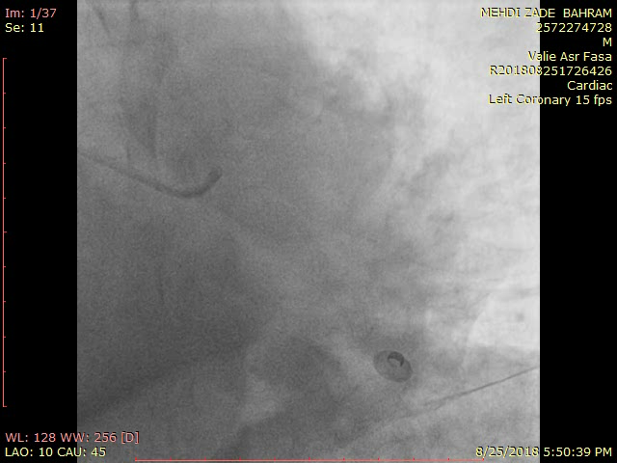
Patient history
79 year old male with acute anterior MI, cardiogenic shock and BP 80 mmhg was sent for primary PCI in another center

Slide 3
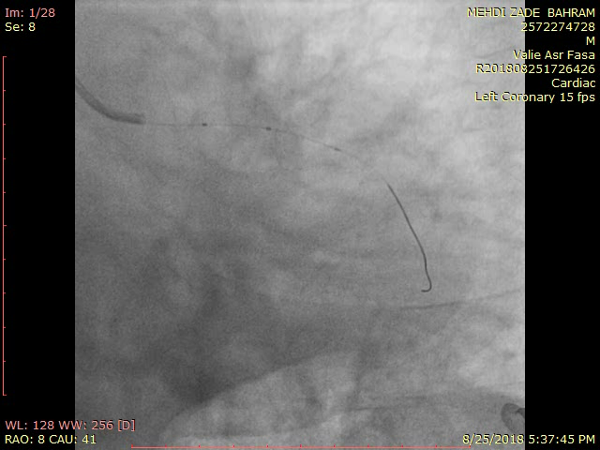
History continued
PCI was failed due to retrovert LAD origin and poor condition of patient, so patient was putted on Integrelin and Levophed and was sent for emergency cardiac surgery and cardiac ICU care to our center

Slide 4
Patient history
Patient was admitted in ICU and early evaluation showed BP: 70 mmhg, massive GI bleeding with hematemesis. Proper medical therapy was started.
Patient was consulted with cardiac surgeon and operation was refused concerning hemodynamic status.
BP 80 mmhg,
Chest pain 7/10
Hgb: 8 mg/dl
What are you going to do
for acute MI patient with cardiogenic shock
and massive GI bleeding? Endoscopy?
CABG Vs. PCI?
If PCI, what type of stent, what antiplatelet?

Slide 5
History continued
Heart team decides to postpone any intervention till GI bleeding was managed and condition improved.
Patient stabilized with leveophed and hydration and integrelin stopped, emergency endoscopy showed erosive gastritis without visible ulcer.
After two days gradually patient improved , BP rised to 100 mmhg
Decision, CABG or PCI
At this stage?

Slide 6
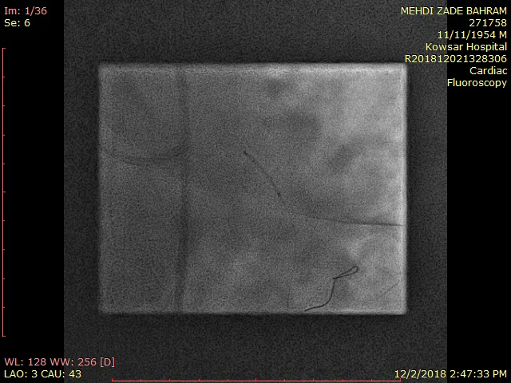
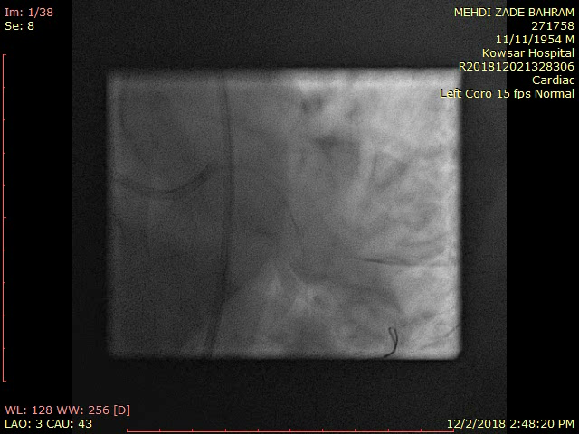
Intervention: what vessel 1st?
Heart team decide for retry of PCI. LAD become subtotal. Plan was opening as much as possible even LAD PCI was failed at this stage, BP was 90 mmhg and patient was stable on table without chest pain. LCX dominant was stented 1st
Result of LCX dominant stenting
3.5-15 direct stening, wire Sion blue 0.014
Post dilation with balloon 3.75-8 NC

Slide 7
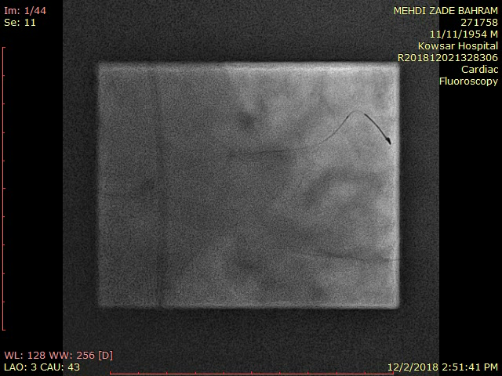
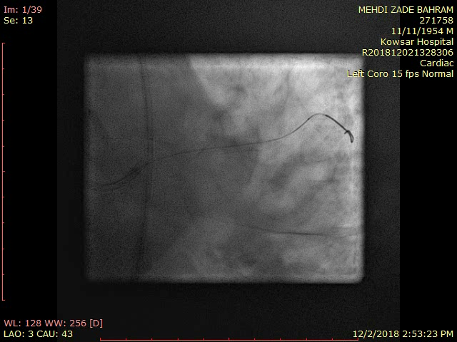
Intervention
Result after postdilation
Then ramus was opened
Stent 2.75-22 Orsiro and postdilated with balloon 3-15 Apollo NC

Slide 8
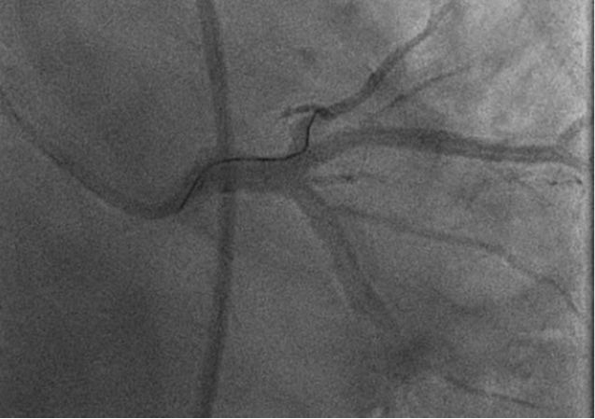
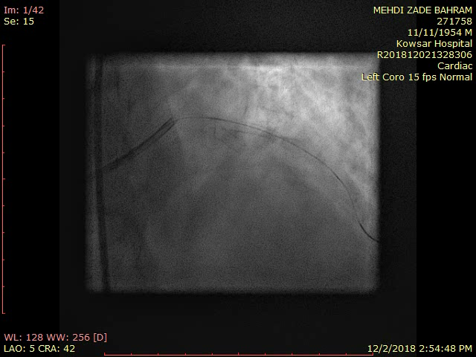
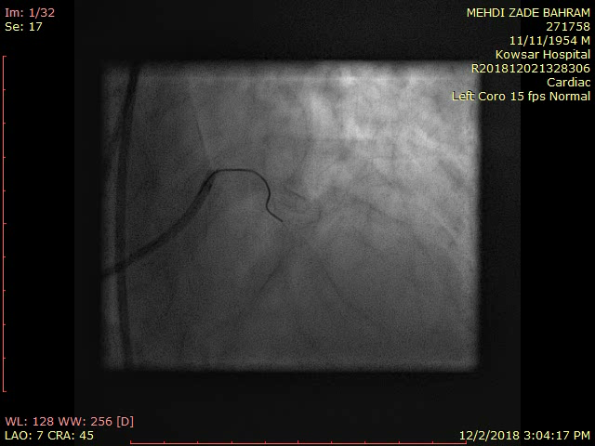
Intervention of LAD
Then focused on LAD. Technique was hairpin wire and wire was pilot 50 0.014

Slide 9
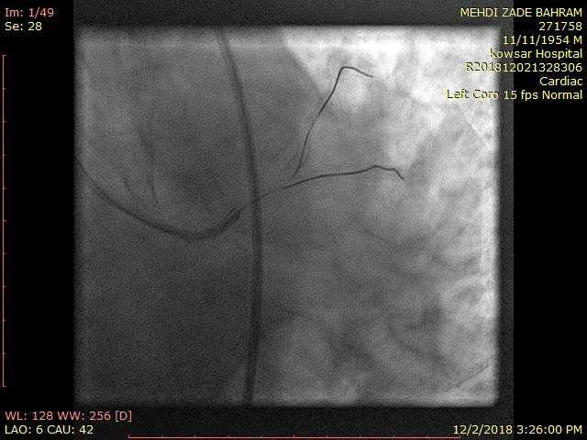
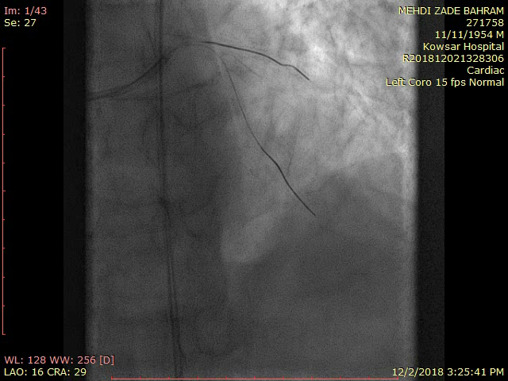
Intervention
At last wire passed predilated with 1.5-12 Sapphire and LAD was stented with Orsiro 2.75-22
And postdilated with balloon 3-12 Apollo NC

Slide 10
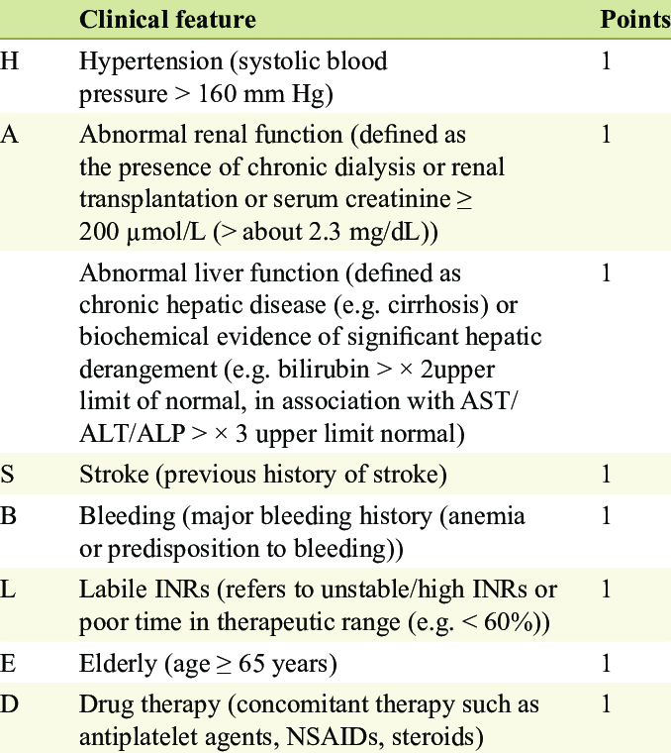
Question 1:What antiplatelet do you give to this patient?
Risk of stent thrombosis
Bleeding risk factors

Slide 11
Question2: which stent is preferred in high bleeding risk patient?

Slide 12
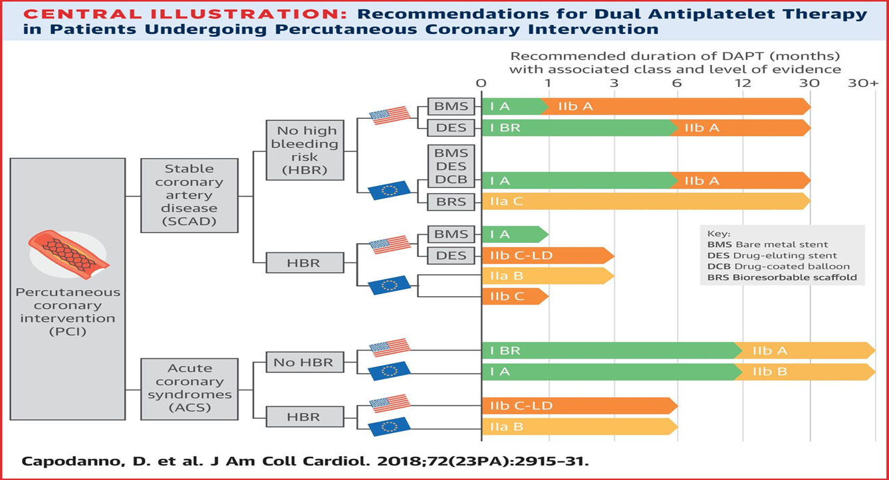
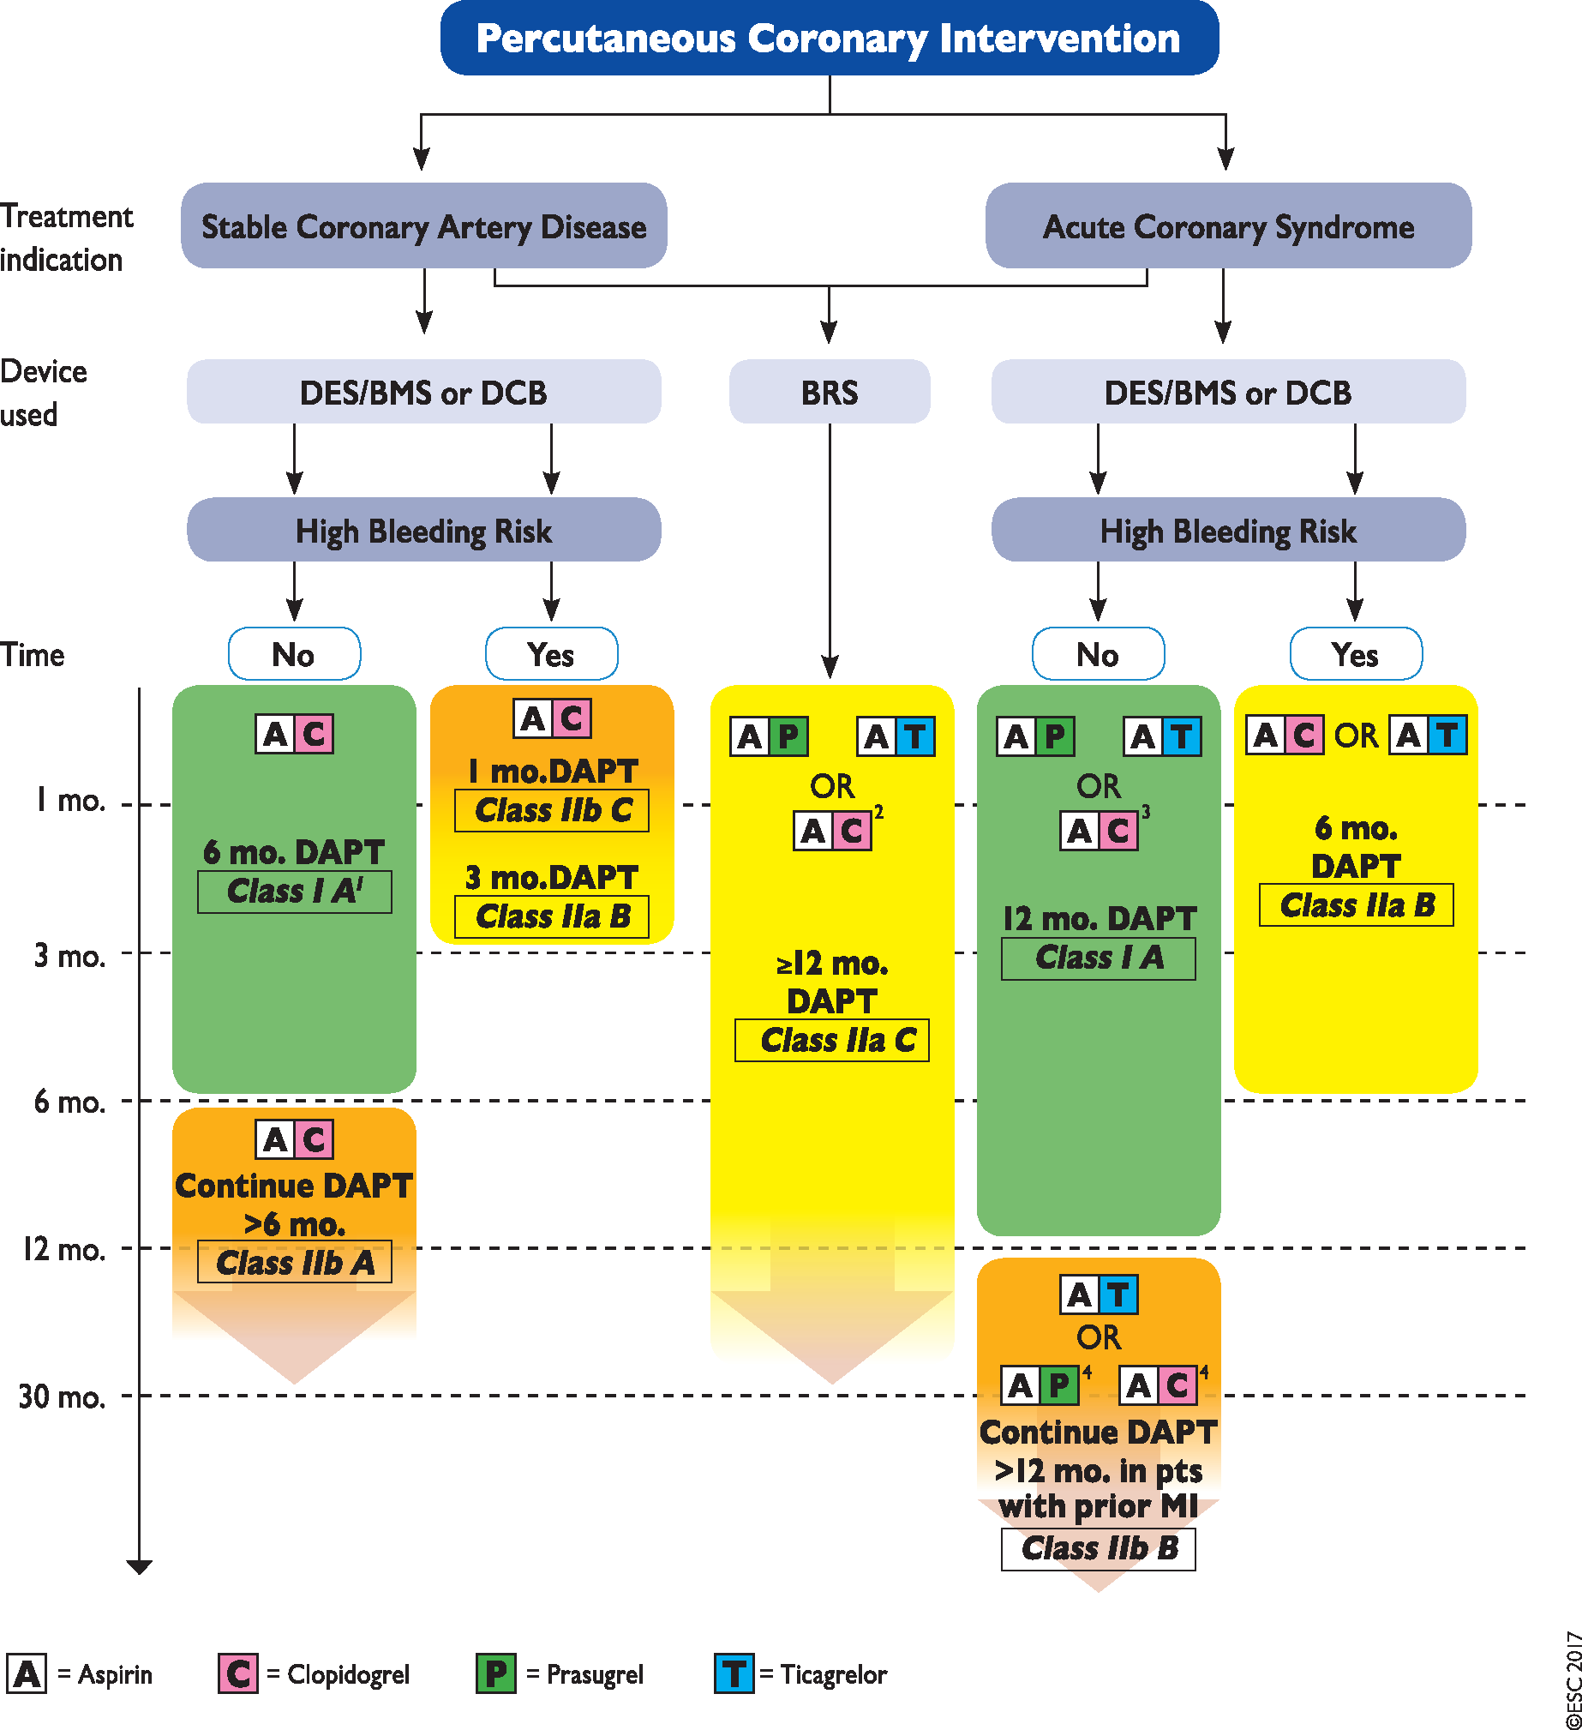

Figure 4 Algorithm for dual antiplatelet therapy (DAPT) in patients treated with percutaneous coronary intervention. ...
How long can we give DAPT ?
Notes:
Figure 4 Algorithm for dual antiplatelet therapy (DAPT) in patients treated with percutaneous coronary intervention. ACS: acute coronary syndrome; BMS: bare-metal stent; BRS: bioresorbable vascular scaffold; CABG: coronary artery bypass graft surgery; DCB: drug-coated balloon; DES: drug-eluting stent; PCI: percutaneous coronary intervention; Stable CAD: stable coronary artery disease.
High bleeding risk is considered as an increased risk of spontaneous bleeding during DAPT (e.g. PRECISE-DAPT score ≥25).
Colour-coding refers to the ESC Classes of Recommendations (green = Class I; yellow = IIa; orange = Class IIb).
Treatments presented within the same line are sorted in alphabetic order, no preferential recommendation unless clearly stated otherwise.
<sup>1</sup>After PCI with DCB 6 months DAPT should be considered (Class IIa B).
<sup>2</sup>If patient presents with Stable CAD or, in case of ACS, is not eligible for a treatment with prasugrel or ticagrelor.
<sup>3</sup>If patient is not eligible for a treatment with prasugrel or ticagrelor.
<sup>4</sup>If patient is not eligible for a treatment with ticagrelor.
Unless provided in the caption above, the following copyright applies to the content of this slide: © 2017 The European Society of Cardiology. For permissions please email: journals.permissions@oxfordjournals.org.The article has been co-published with permission in the European Heart Journal [DOI: 10.1093/eurheartj/ehx419] on behalf of the European Society of Cardiology and European Journal of Cardio-Thoracic Surgery [DOI 10.1093/ejcts/ezx334] on behalf of the European Association for Cardio-Thoracic Surgery. All rights reserved in respect of European Heart Journal, © European Society of Cardiology 2017. The articles are identical except for minor stylistic and spelling differences in keeping with each journal's style. Either citation can be used when citing this article.

Slide 13
Duration of DAPT trials
AHA 2019

Slide 14
Who benefit from long term DAPT?
AHA 2019

Slide 15
Twilight study
Mehran R, et al. Ticagrelor with or without aspirin in high-risk patients after PCI. N Engl J Med 2019; Sep 26.
Among patients with high-risk percutaneous coronary intervention who had completed three months of dual antiplatelet therapy with ticagrelor, patients who were randomized to ticagrelor alone experienced similar ischemic outcomes and a lower risk of bleeding at one year compared with those maintained on ticagrelor and aspirin

Slide 16
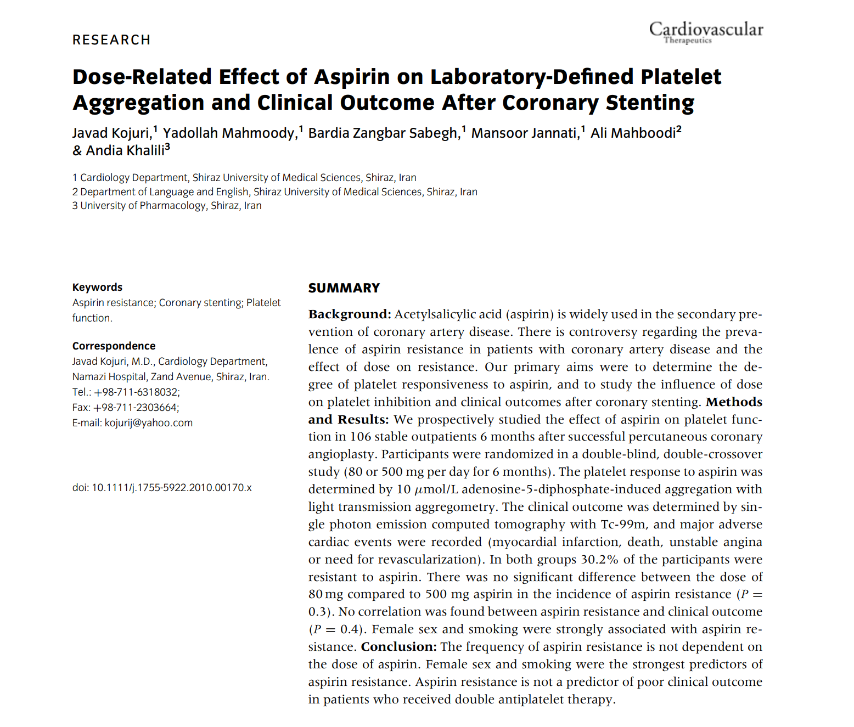
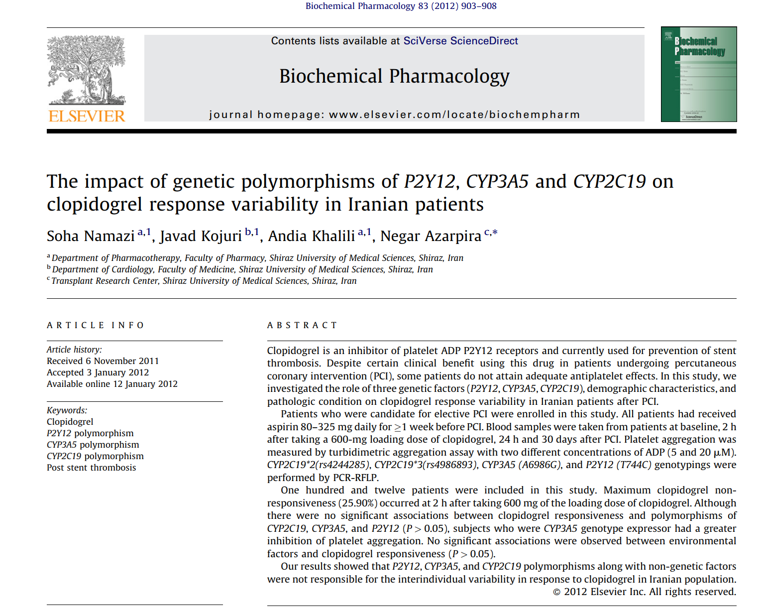
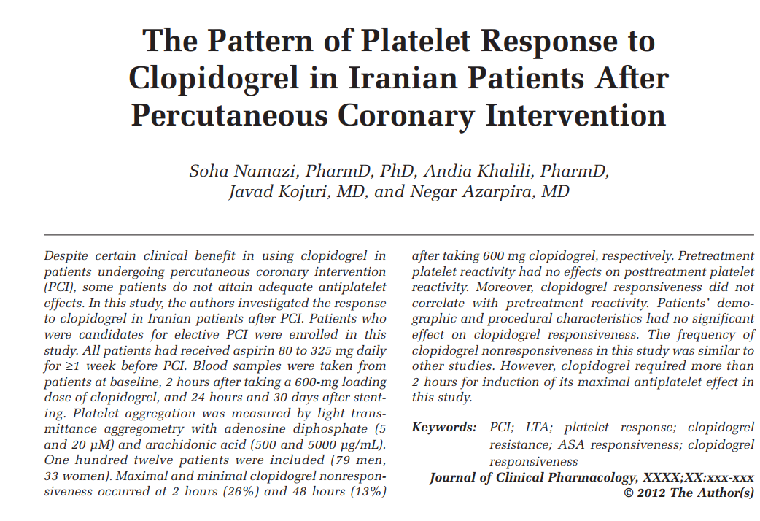
Research first!

Slide 17

Case follow up
Patient was putted on ASA and Plavix and discharged 5 days later,
and after 1 month ASA was stopped and patient continue Plavix alone
References :
AHA 2019, commentary
Mehran etal, Twilight study
Capodanno D, Alfonso F, Levine GN, Valgimigli M, Angiolillo DJACC/AHA Versus ESC Guidelines on Dual Antiplatelet Therapy: JACC Guideline Comparison. J Am Coll Cardiol 2018;72:2915-2931
Patrik erruys etal. Global leadrer trial. 2018 JACC
ESC guideline of DAPT 2017. Anders Jeppsson Mate Petricevic Philippe Kolh Marco Valgimigli. European Journal of Cardio-Thoracic Surgery, Volume 53, Issue 1, 1 January 2018.
Polymer-free Drug-Coated Coronary Stents in Patients at High Bleeding Risk, leader free trial. Philip Urban, Ian T. Meredith, Alexandre Abizaid, NEJM 2015
Krishnankutty Sudhir,James B. Hermiller, Joanne M. Ferguson,and Charles A. SimontonRisk Factors for Coronary Drug-Eluting Stent Thrombosis: Influence of Procedural, Patient, Lesion, and Stent Related Factors and Dual Antiplatelet Therapy.HindawiVolume 2013, Article ID 748736, 8 pages
Welcome to Shiraz

